Slide 2
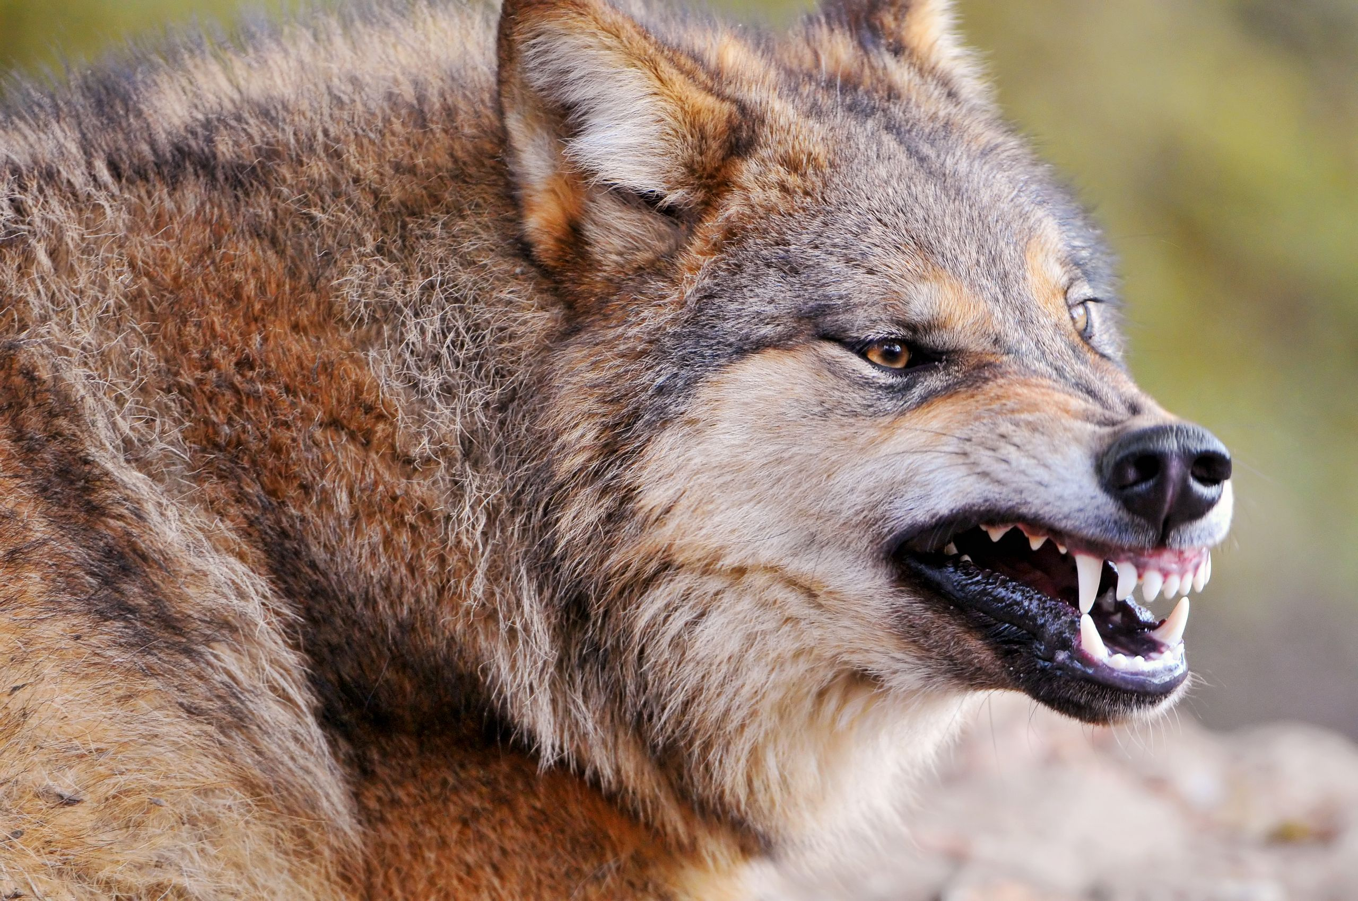
False Teaching Seminar
Maintaining Sound Doctrine
Central Valley School of Ministry

Slide 3
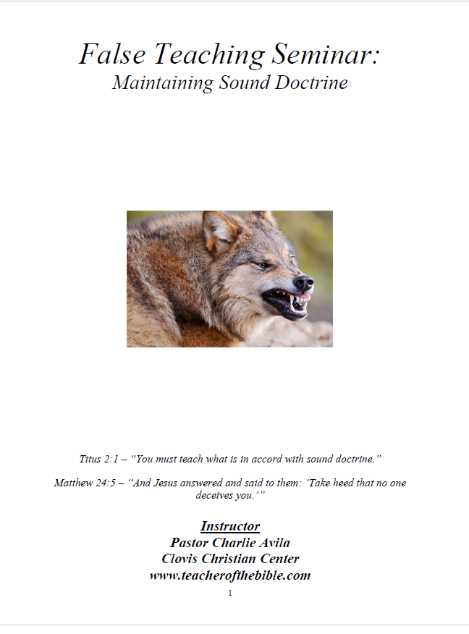
10-Page Outline www.teacherofthebible.com

Slide 4
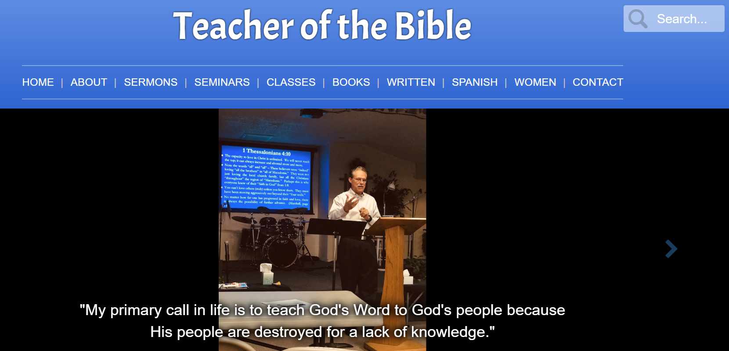
SEMINARS

Slide 5



Trilogy of Books on Amazon

Slide 6
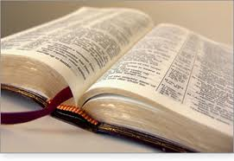
Session #1
2 Peter 2:1-3
2 Peter 3:16

Slide 7
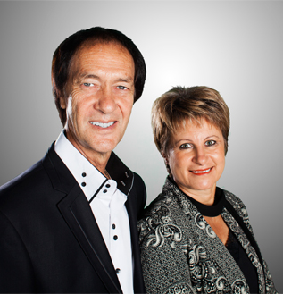

Kobus Van Rensburg

Slide 8

“Prophet” Kobus
Kobus died on December 21, 2013 at the age of 61 after a long battle with cancer.

Slide 9
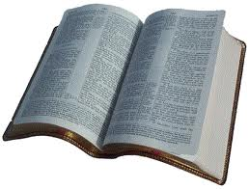
The Bible
Of the 27 books of the NT, 26 speak of false teaching and false ministers.

Slide 10
The Apostles Have Warned Us
All of the Greek verbs above are imperative, that is, we are being commanded.

Slide 12
Session #2
Luke 6:22-23, 26

Slide 13
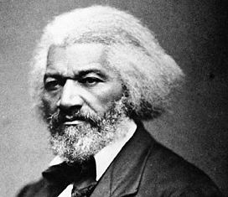
Frederick Douglass
Sermon – 1863
“Popular Error and Unpopular Truth.”

Slide 14
2 Corinthians 11:13-15
“For such are false apostles, deceitful workers, transforming themselves into apostles of Christ. And no wonder! For Satan himself transforms himself into an angel of light. Therefore it is no great thing if his ministers also transform themselves into ministers of righteousness.”

Slide 15
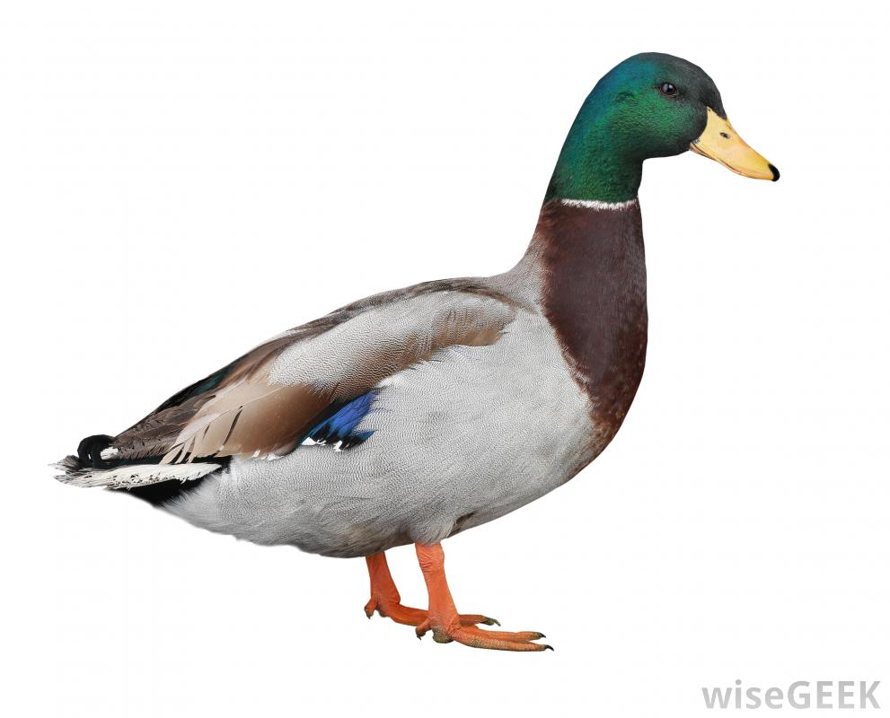
What is it?

Slide 16
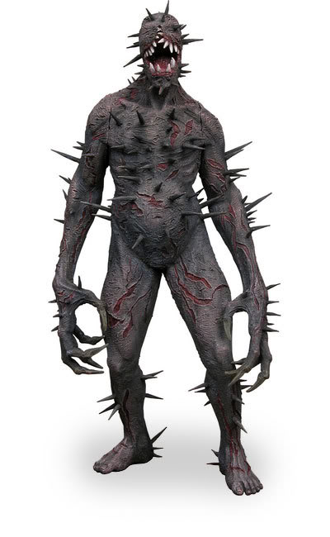
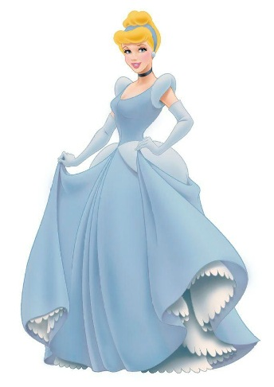
How do they appear?

Slide 17
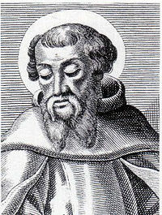
Irenaeus
“Error, indeed, is never set forth in its naked deformity, lest, being thus exposed, it should at once be detected. But it is craftily decked out in an attractive dress, so as, by its outward form, to make it appear to the inexperienced more true than truth itself.”

Slide 18


Rob Bell

Slide 19
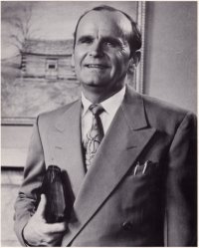
William Branham
A-B-R-A-H-A-M (7)
G-R-A-H-A-M (6)
B-R-A-N-H-A-M (7)

Slide 20
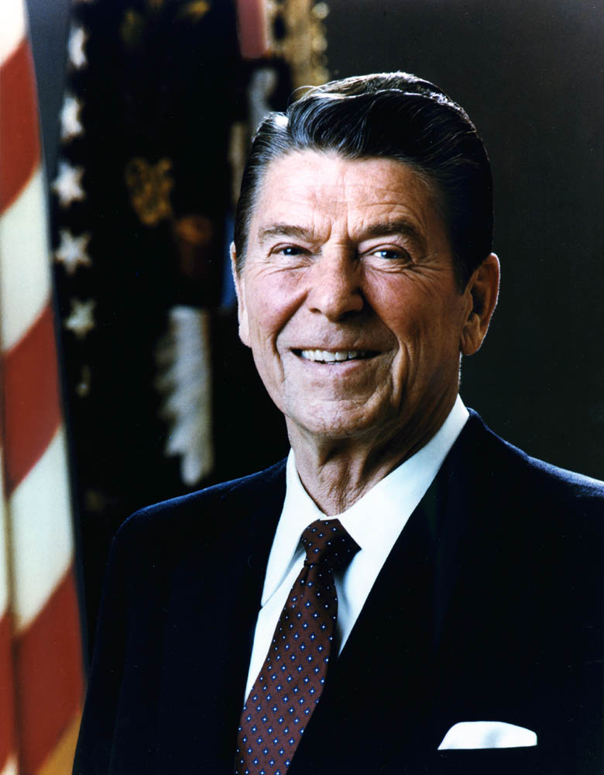
AntiChrist?
Ronald (6) Wilson (6) Reagan (6) = 666

Slide 21

Cyrus Anointing?
Isaiah 45:1 – “This is what the Lord says to His anointed, to Cyrus, whose right hand I take hold of to subdue nations before him and to strip kings of their armor, to open doors before him so that gates will not be shut.”

Slide 22
What is the Root Problem?
An unteachable spirit is the root of all heresy.
“Despise authority” (2 Peter 2:10)
“Reject authority” (Jude 8).

Slide 23

Carlton Pearson
He wouldn’t listen to his church.
He wouldn’t listen to church leaders.
He wouldn’t listen to his mentors.
He wouldn’t listen to his overseers.

Slide 24


Movie – Books

Slide 25
A Corrupt Lifestyle
10 verses in the NT that deal with false teaching/teachers use the word “corrupt” or “corruption.”

Slide 26
What Will It Produce?
It will produce a rising up and a drawing away.

Slide 27
Key Point
Most false teachings have something wrong regarding the person, nature, or character of Jesus Christ of Nazareth.

Slide 28

“Plus or Minus” Jesus

Slide 29
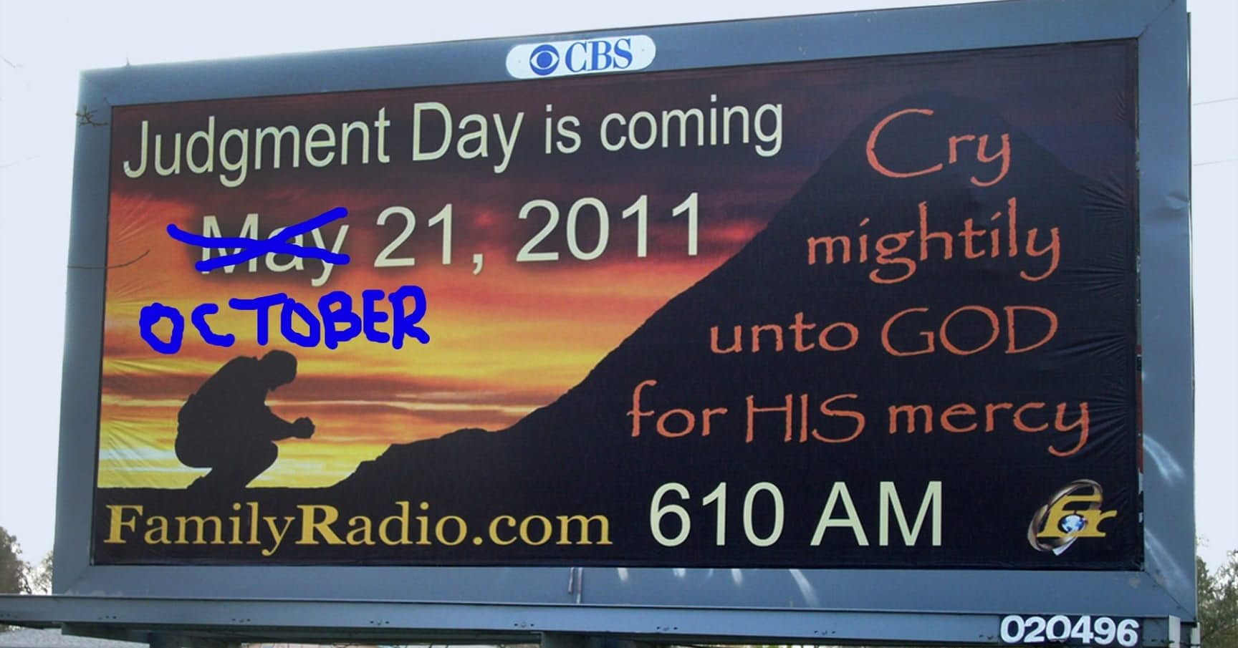
Harold Camping’s Predictions

Slide 31
Session #3
1 John 4:1-6

Slide 32

Dealing with False Teaching
You cannot be silent.

Slide 33
Galatians 1:8-9
“But even if we, or an angel from heaven, preach any other gospel to you than what we have preached to you, let him be accursed. As we have said before, so now I say again, if anyone preaches any other gospel to you than what you have received, let him be accursed.”

Slide 34
2 Peter 2:1-2
“There will be false teachers among you, who will secretly bring in destructive heresies, even denying the Lord who bought them, and bring on themselves swift destruction. And many will follow their destructive ways, because of whom the way of truth will be blasphemed.”

Slide 35
Dealing with Heretical Teaching
Heresies are destructive.

Slide 37
Session #4
2 Timothy 4:1-5

Slide 38
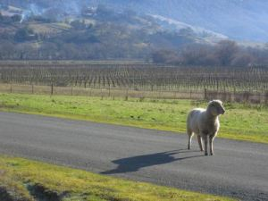
The Nature of Sheep
Remember: Sheep are always straying.

Slide 39
Scripture
Hosea 4:6 – “My people are destroyed for lack of knowledge.”
Not “hurt,” not “injured,” not “wounded,” but “destroyed!”

Slide 40

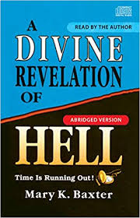




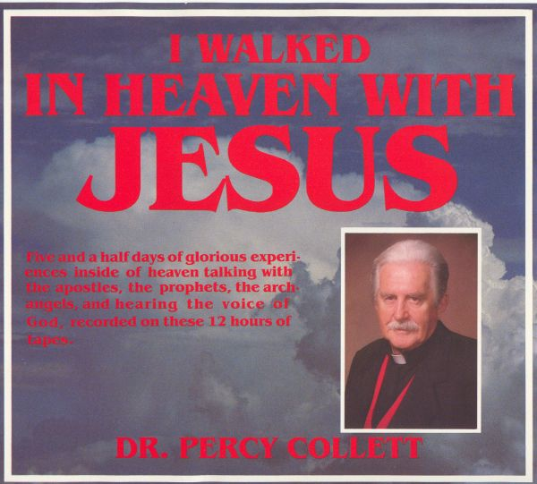



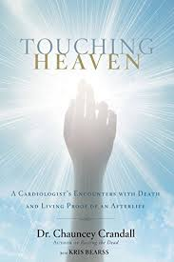




So Many Books!!!

Slide 41
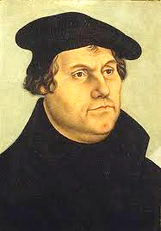
Martin Luther Quote
“I have made a covenant with God that He sends me neither visions, dreams, nor even angels. I am well satisfied with the gift of the Holy Scriptures which give me abundant instruction and all that I need to know both for this life and for that which is to come.”

Slide 42
Luke 16:29-31
Luke 16:29-31 – “Abraham said to him, ‘They have Moses and the prophets; let them hear them.’ And he said, ‘No, father Abraham; but if one goes to them from the dead, they will repent.’ But he said to him, ‘If they do not hear Moses and the prophets, neither will they be persuaded though one rise from the dead.’”

Slide 43

Titus 2:7-8
Integrity
Reverence
Incorruptibility
Sound Speech

Slide 44

Question
“Not by might nor by power, but by My Spirit.”

Slide 45
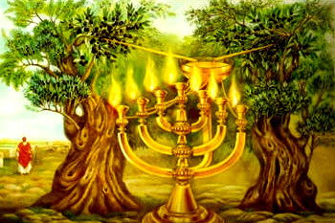

Slide 46
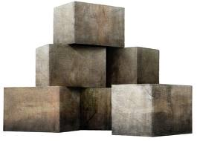
6 Foundation Stones
Repentance
Faith in God
Doctrine of Baptisms
Laying on of Hands
Resurrection of the Dead
Eternal Judgment

Slide 47
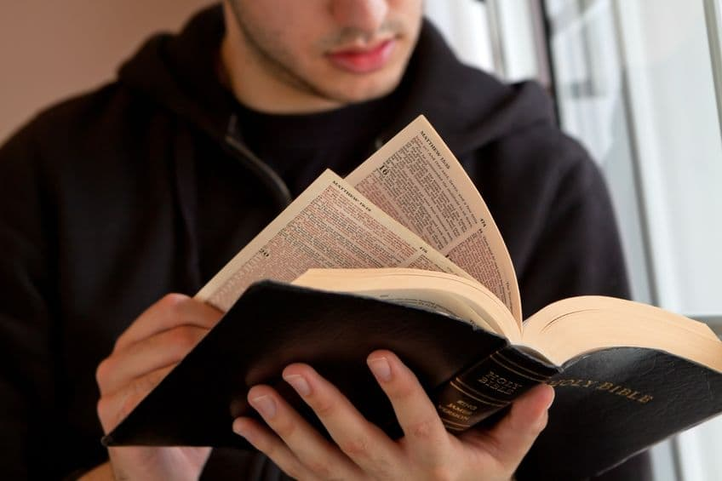

Read & Study the Bible

Slide 48
Further Teachings
Balaam – The Prototype False Prophet
Jeremiah & the False Prophets
The Trinity & the Incarnation
The Divinity of Jesus – Hebrews 1

