Slide 2
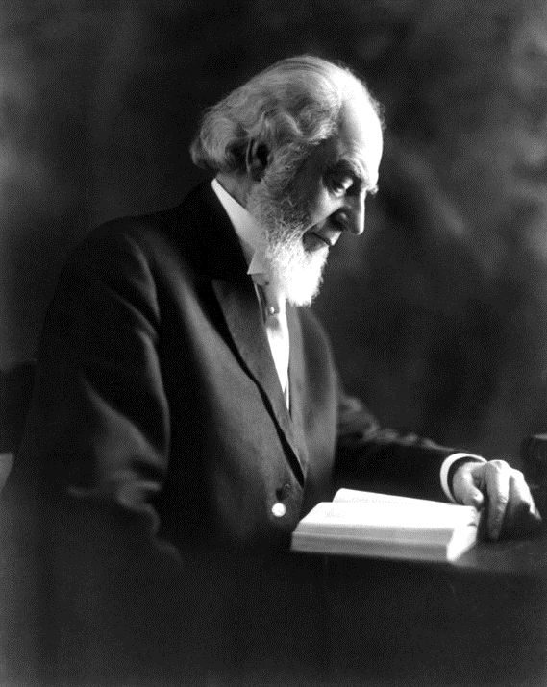
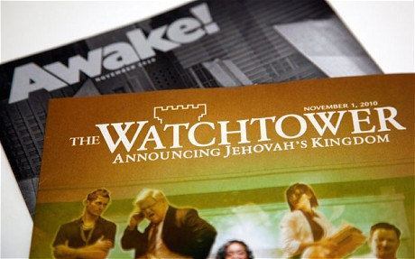
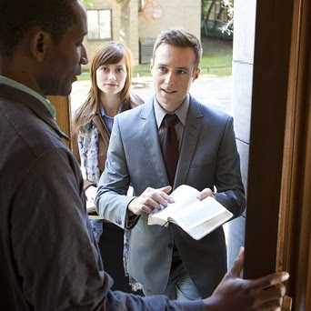
Witnessing to Jehovah’s Witnesses

Slide 3
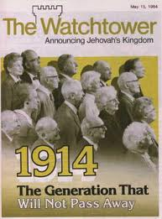

Session 1
Witnessing to Jehovah’s Witnesses – An Introduction

Slide 4

Scripture
Isaiah 43:10

Slide 5

The Most Critical
“The belief that the Watchtower Bible and Tract Society is “God’s organization” (the ONLY ONE) on earth is the central and most important doctrine of the Jehovah’s Witnesses.”
Answering Jehovah’s Witnesses, Subject by Subject by David Reed, page 117

Slide 6
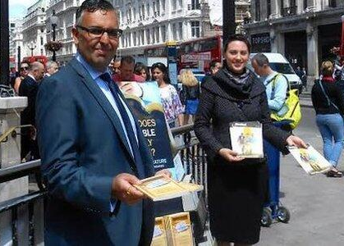
How JW’s See Themselves
We are the only ones on earth who have the TRUTH.
The ONLY “channel of communication” that God uses today and the only means of salvation is the Watchtower organization.
The ONLY authorized interpreter of “biblical” truth is the JW’s Governing Body and the Watchtower Society. All others are false.

Slide 7
How JW’s See Themselves
We can never reject the teachings or beliefs of “God’s only organization” because that would make us apostates (traitors). We should be disfellowshipped if we do so.
Only JW’s will escape from Armageddon. All others will be destroyed.
Only JW’s will inherit the paradise earth.
I am the teacher – I’m the only one with the truth – so I must go door to door and teach all the lost people, especially Christians, what the Bible is really teaching.

Slide 8
How JW’s See Christians
All Christians are deceived and part of the Great Babylon.
The doctrines of the Trinity and deity of Jesus are satanic lies. The “3-headed monster” or “greatest heresy.”
The Pastors especially are antichrists and deceivers.
JW’s are the only ones with the truth, and we must reach Christians before it’s too late.

Slide 9
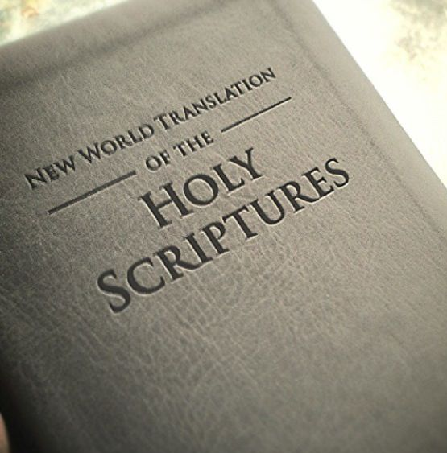
How JW’s See Christians
All the Bible translations that Christians use are filled with lies. ONLY the RNWT put out by the Watchtower is the world’s true translation.
The original true gospel – which Jesus and Paul preached – has been corrupted by Christendom. Only when C. T. Russell came did the true gospel get preached again for the first time since the beginning.

Slide 10
Christians Talking to JW’s
Colossians 4:6 – “Let your speech always be with grace, seasoned with salt, that you may know how you ought to answer each one.”
“When you talk, you should always be kind and pleasant so you will be able to answer everyone in the way you should.” (NCV)
1 Peter 3:15 – “Always be ready to give a defense to everyone who asks you a reason for the hope that is in you, with meekness and fear.”
“Answer them in a gentle way with respect.” (ERV)

Slide 11
Christians Talking to JW’s
2 Timothy 2:24-25 – “A servant of the Lord must not quarrel but be gentle to all, able to teach, patient, in humility correcting those who are in opposition, if God perhaps will grant them repentance, so that they may know the truth.”
“Gently instruct those who oppose the truth.” (NLT)

Slide 12
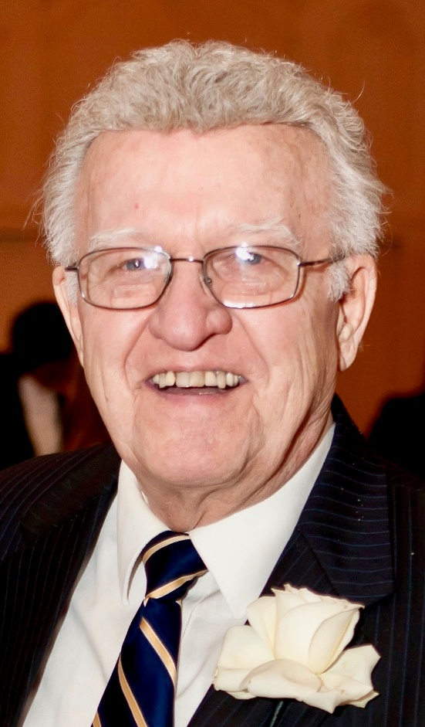
Christians Talking to JW’s
“The only effective method of winning a cultist to Christ – use a gracious, low-key approach.”
Kicked out of the Kingdom, Charles Trombley, page 67

Slide 13
Christians Talking to JW’s
A JW elder “was told directly he was in a cult, that he was in league with the devil, that he was a false prophet, and that he was going to hell.” Do you think any of this hostility won this man to Christ? Of course not. It only served to convince him that he was indeed in the true religion and was being persecuted because of his loyalty to Jehovah.
Getting Through to Jehovah’s Witnesses, David Englund, page 37

Slide 14
Christians Talking to JW’s
“Jesus Christ is Lord of lords and King of kings. He is the Word who is God who was made flesh. He is Emmanuel, God with us. He is the Lamb of God whom all creation worships. He is the Son of God, and Father God told Him, Your throne, O God, is forever and ever. He is God manifested in the flesh. The Son Jesus Christ is the true God and eternal life. We are looking for the glorious appearing of our great God and Savior Jesus Christ. In Him dwells all the fullness of the Godhead bodily.”

Slide 15
Christians Talking to JW’s
“The JW will reject whatever you say because it is coming from you instead of from ‘the channel of communication that God uses,’ namely ‘God’s organization,’ the Watchtower Society. Even if your arguments are convincing, the JW sees them as very clever lies crafted by Satan, because he believes that you represent the devil’s organization.”
Answering Jehovah’s Witnesses, page 13

Slide 17
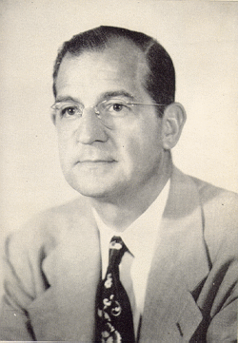
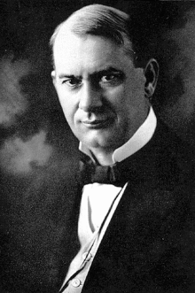
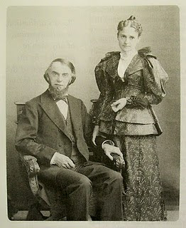
Session 1
Witnessing to Jehovah’s Witnesses – Their History

Slide 18
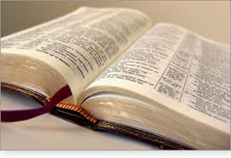
Scripture
Matthew 24:45-47

Slide 19
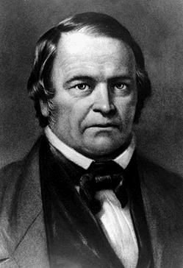
Adventist Origins of JW’s
William Miller (1782-1849) was a Baptist layman.
Studied the Bible intensely from 1816-1818. Christ would come in 25 years or 1843.
He used the “2,300 evenings-mornings” of Daniel 8:14 and converted them into years.
First, it was March 1843, then it was March 1844, then it was October 22, 1844.

Slide 20
Adventist Splits
Advent Christian
Church
Second
Adventist
Seventh-Day
Adventists
Life and Advent
Union

Slide 21
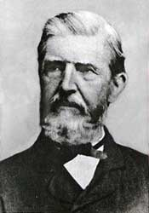
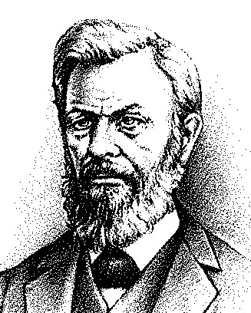
Adventist Origins of JW’s
George Storrs (1796-1879), publisher of the Bible Examiner and founder of the Life and Advent Union, said 1870 was the year.
Nelson Barbour (1824-1905), publisher of Herald of the Morning, said that it was 1873, then 1874.
When Jesus didn’t come in 1874, Barbour said that He came invisibly (“Parousia” can also be translated “presence,” not just “coming”).

Slide 22
Adventist Origins of JW’s
Barbour wrote a book called Three Worlds in 1877, and jointly published it with Charles T. Russell. Barbour calculated that 3½ years after Christ’s return, the saints would be raptured and the gospel age would end in 1878.
Barbour used 1,845 years as the time period from the death of Jacob to the death of Christ in AD 33. Then 33 plus 1845 came to 1878.
John Aquila Brown published a book called Even-Tide in 1823 in London that was full of prophetic dates and speculation.

Slide 23
Crazy Calculations!!!
604 BC when the kingdom of Judah fell under Gentile rule (Nebuchadnezzar).
The “7 times” of Nebuchadnezzar’s madness in Daniel Chapter 4 was the “until the times of the Gentiles was fulfilled” of Luke 21:24.
7 X 360 prophetic days (years) = 2,520 years. 2,520 divided by 2 = 1,260 years.
604 BC + 2,520 years = 1917.
Barbour said that Brown was off a few years, and his calculations landed in the autumn of 1914. (Barbour later abandoned all his math.)

Slide 24
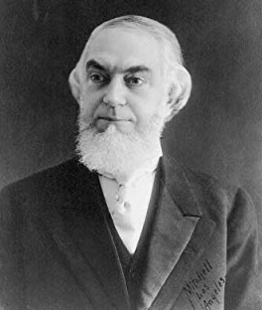
Charles Taze Russell
Russell was born in Pittsburgh in 1852 to Christian parents.
At a young age, he became a skeptic of Bible truths by first denying eternal punishment (in hell).
He was greatly influenced by Storrs, Barbour, and Stetson.
In 1879 he published the periodical, Zion’s Watchtower and Herald of Christ’s Presence.

Slide 25
Charles Taze Russell
Also in 1879, he married Maria Ackley. They divorced in 1913. They had no children.
In 1881, he organized Zion’s Watchtower Tract Society of Pennsylvania, which was the forerunner to the Jehovah’s Witnesses (1931).
In 1882, he denied the doctrine of the Trinity, said it was satanic, a “heathen doctrine,” and equivalent to “Hindooism.” Also taught that Jesus was a created being (He was Michael the archangel in heaven), and denied the bodily resurrection of Jesus.
He organized groups into “Bible Students.”

Slide 26
JW Beliefs About Russell
“The greatest man that has lived since the Apostle Paul.” “He was the greatest religious teacher since St. Paul, and did more than any other man of modern times to establish the faith of the people in the Scriptures.” “He was the only one permitted to understand” the Bible.
“Thousands of the readers of his writings believe he filled the office of ‘that faithful and wise servant’ of Matthew 24:45-47, who alone was given the work of giving ‘meat in due season’ and to be ‘ruler over his household.’”

Slide 27
Exclusive Beliefs
Jesus and Paul preached the true gospel in the First Century.
All the creeds, writings, doctrines and churches of Christendom since that time are false.
It was only now, in the late 1800’s, that God chose to reveal the true gospel again to Charles Taze Russell.
So, they believe that Russell did not come up with a new sect, denomination, or religious group; rather, Russell discovered the original gospel that was preached in the First Century.

Slide 28
Russell’s Eschatology
1874 – That Jesus Christ had come invisibly to rule on earth.
1878 – That the rapture would occur and take the saints away.
1914 – That the final end of the kingdoms of this world would come (the end of the Times of the Gentiles), and the Kingdom of God would be fully established in the heavens.
Russell passed away on October 31, 1916.

Slide 29


Editorial Committee
Page
Van Amburgh
Rockwell
Brenneisen
Robison
Burgess
Hirsh
Hoskins
Rutherford
Edgar

Slide 30
Joseph F. Rutherford
Was born in 1869. He was a trial lawyer and judge in Missouri, was baptized in 1906, and became legal counsel in 1907.
He became president of the movement in 1917. Very strong-willed, authoritarian leader.
In 1918, Rutherford and 8 other executives were charged and convicted of sedition and sentenced to 20 years in prison.

Slide 31
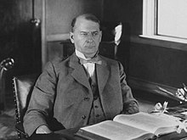
JW’s Under Rutherford
JW’s do not participate in military service, saluting the flag, or involvement in any political office.
From 1918-1920, the door to door proselytizing begins. Rutherford demanded detailed reports of all witnessing activities. (Acts 20:20)
In 1925, he predicted that the millennium would begin. This caused a great deal of excitement.

Slide 32
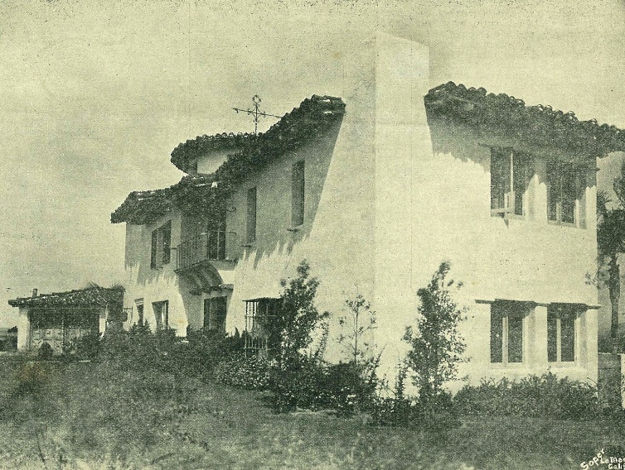
JW’s Under Rutherford
In 1929, Beth Sarim (“House of the Princes”) was built in San Diego for the coming “resurrected princes.”
In July 26, 1931, the name was officially changed to “Jehovah’s Witnesses.”
In 1932, abolished “elders” at the local churches and called the movement a “theocratic government.”

Slide 33
JW’s Under Rutherford
In 1935, because Rutherford believed Jesus came invisibly in 1914, and the church age officially ended, they named their buildings, “Kingdom Halls.”
On May 31, 1935, Rutherford announced at a convention in Washington D.C., that the 144,000 heavenly class of believers was fulfilled. This “little flock” of Luke 12:32 were the only ones truly born again and allowed into heaven to rule with Jesus.
The new “present truth” was that a second class group would stay here on earth. They are the “great crowd” of Revelation 7:9 or “other sheep” of John 10:16. Their destiny is a paradise earth.

Slide 34
JW’s Under Rutherford
Rutherford died at Beth Sarim on January 8, 1942.
“In a real sense it was he, rather than Russell, who developed the Jehovah’s Witnesses in what they are today.”
Apocalypse Delayed, The Story of the Jehovah’s Witnesses, M. James Penton, page 103
On January 13, 1942, Nathan H. Knorr became the 3rd President of the Jehovah’s Witnesses. He would help shape it “into a major religious force of millions.”

Slide 35
Nathan Homer Knorr
He was born in 1905, was raised in a Christian church, but baptized as a “Bible Student” in 1923. He would oversee the worldwide expansion of JW’s.
In 1943, he began the missionary training school called Gilead in New York.
In 1945, the JW’s began the refusal of blood transfusions.
In 1950, the NWT was introduced.

Slide 36
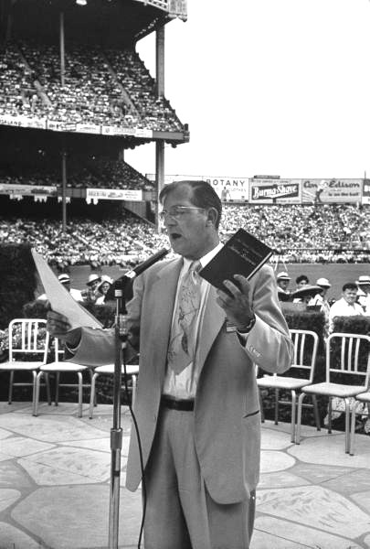
JW’s Under Knorr
In 1953, he married Audrey Mock.
JW branch offices expanded greatly under Knorr’s leadership.
In 1958, he preached to 253,000 JW’s at Yankee Stadium and the Polo Grounds.
In 1975, F. Franz predicted that mankind’s 6,000-year history on earth would end and Christ would begin His millennial rule on earth.

Slide 37
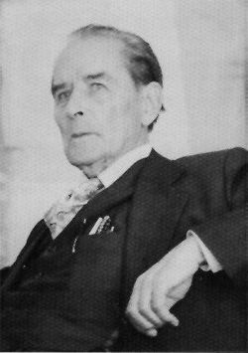
Frederick W. Franz
Born in 1893, he was baptized in a Lutheran church and later wanted to be Presbyterian preacher.
He attended the University of Cincinnati and studied Biblical Greek for two years, and was self-taught in several other languages.
He has always been considered the main “theologian” of the JW’s.

Slide 38
JW’s Under Franz
Franz was a life-long bachelor. He never married.
The JW’s would never give the credentials and names of the translators of the NWT, but Raymond Franz said it was his uncle who was the major author of the translation.
Because he lived to be nearly 100 years old, and knew Russell, Rutherford, and Knorr personally, he was greatly revered by JW’s.
After Rutherford’s death, he was the main writer of published Bible articles in the JW’s magazines.

Slide 39
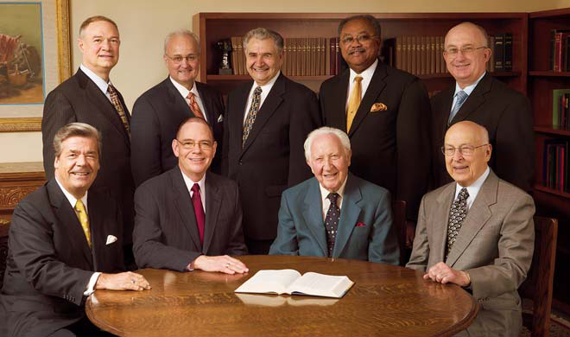
Governing Body
Since 1975, the Governing Body has been the supreme ruling council of the JW’s.
It has had between 7 and 18 members over the years depending on deaths and new appointments.
In 1983, Raymond Franz gave a devastating and detailed account of the secret dealings of the GB in his book.

Slide 40
Governing Body
Every doctrinal, organizational, or practical directive issued by the GB is completely binding upon all JW’s. This body is the main channel through which God’s speaks today according to JW’s.
The GB maintains strict and total control over everything that involves the JW’s.
They are the faithful and wise slave of Matthew 24.
The new world headquarters of the JW’s is in Warwick, New York and no longer Brooklyn.

Slide 42

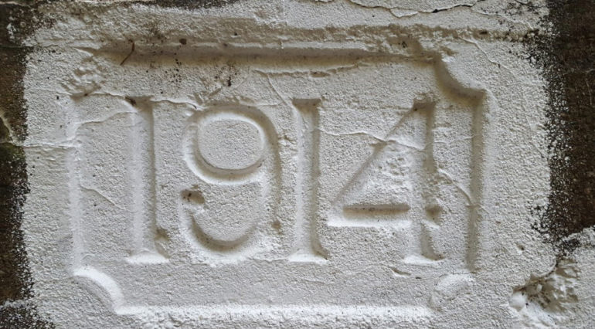
Session 2
Witnessing to Jehovah’s Witnesses – Their Beliefs

Slide 43
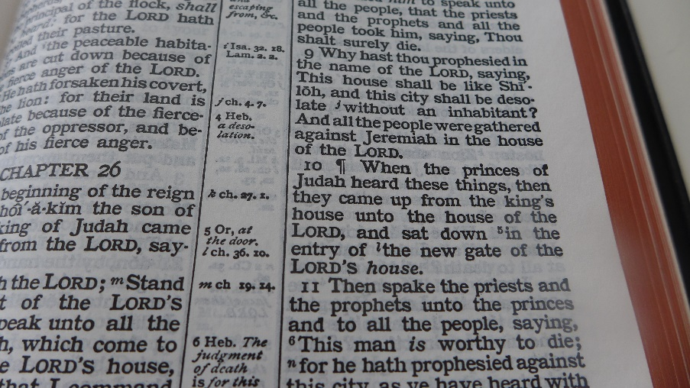
Scripture
Psalm 83:18
Exodus 6:3
“The JW Verse”

Slide 44
Of Critical Importance
Proverbs 4:18 – “But the path of the righteous is like the bright morning light that grows brighter and brighter until full daylight.” (RNWT)
2 Peter 1:12 – “For this reason I will not be negligent to remind you always of these things, though you know and are established in the present truth.”
If the President of the Watchtower Society or the Governing Body receives new revelation or understanding from Jehovah, that replaces previous truths. They believe in progressive revelation.
Raymond Franz wrote that “past truth,” “present truth,” and “future truth” make truth “meaningless.”

Slide 45
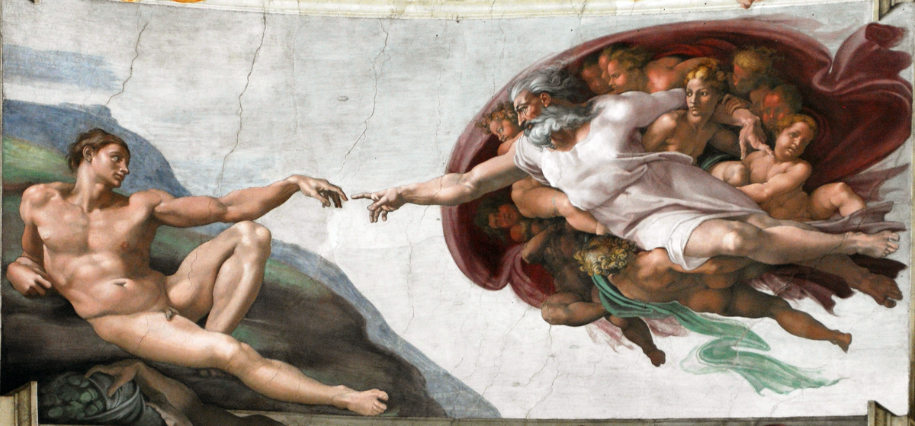
JW Beliefs About God

Slide 46
JW Beliefs About God
JW’s deny the Trinity and the deity of Jesus Christ (he is a created angel), and teach that the Holy Spirit is an impersonal (active) force.
The famous John 1:1 is translated, “The Word was a god…” (RNWT). So JW’s have “a big God, a little god, and a force.” Answering Jehovah’s Witnesses, page 115
Rutherford, in Let God Be True, page 82, taught that the originator of the Trinity was Satan himself.
JW writers represent the Trinity as three gods in one person. They call it “the three-headed monster.”

Slide 47
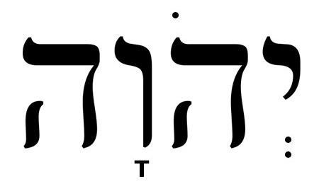
JW Beliefs About God
The Tetragrammaton or name of God in Hebrew is YHWH or Jehovah. It is traditionally translated “LORD” in our Bibles.
It upsets JW’s that you call God, “Lord.” They want you to use “Jehovah.”
“The vindication of Jehovah is the whole theodicy of the JW’s and the essence of their whole theology.” N. H. Knorr

Slide 48

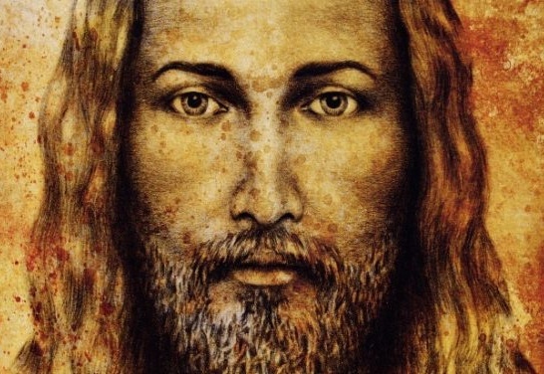

JW Beliefs About Jesus Christ

Slide 49
JW Belief – Jesus is Michael
“Jesus Christ, whom we understand from the Scriptures to be Michael the archangel…” The Watchtower, Feb 15, 1979, page 31
“Jesus Christ further deserves honor because he is Jehovah’s chief angel, or archangel.” The Watchtower, Feb 1, 1991, page 17
Michael the archangel is mentioned by name five times – Daniel 10:13, 10:21, 12:1; Jude 9; Revelation 12:9.

Slide 50
JW Belief – Jesus is Michael
“Prior to His incarnation, He was known as Michael the archangel. He was ‘a god,’ but not God.” Angels of Deceit, page 225
“Why do we conclude that Jesus is the archangel Michael? God’s Word mentions only one archangel, and it speaks of that angel in reference to the resurrected Lord Jesus: ‘The Lord himself will descend from heaven with a commanding call, with an archangel’s voice and with God’s trumpet.’ (1 Thessalonians 4:16). At Jude 9, we find that this archangel’s name is Michael.” The Watchtower, April 15, 1991, page 28

Slide 51
Review
1) “God’s Word mentions only one archangel.
2) It speaks of that angel in reference to the resurrected Lord Jesus.
3) This archangel’s name is Michael.”
Answering Jehovah’s Witnesses, page 158

Slide 52
JW Beliefs About Jesus
Michael, in his pre-existent state, was the Son of God in heaven. When he came to earth, Michael changed into a earthly, bodily state as a man. This man was named Jesus Christ.
When Jesus is raised from the dead, it was “to become again a spirit Son of God.” They believe “His body is laid in the grave and then was dissolved into gas or preserved somewhere.” “So His resurrection was a transformation from His human state to a spirit state.”
They believe that Michael gave up his heavenly life to become Jesus; Jesus gave up his earthly life to return to heaven as Michael.

Slide 53

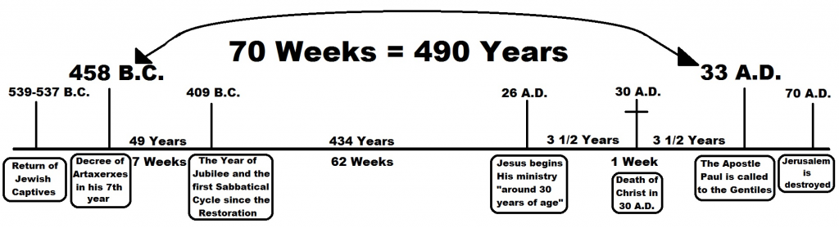
JW Eschatology

Slide 54
Let Us Remember!
Matthew 24:36 – “But of that day and hour no one knows, not even the angels of heaven, but My Father only.”
Matthew 25:13 – “Watch therefore, for you know neither the day nor the hour in which the Son of Man is coming.”
Mark 13:32 – “But of that day and hour no one knows, not even the angels in heaven, nor the Son, but only the Father.”
Luke 12:40 – “Therefore you also be ready, for the Son of Man is coming at an hour you do not expect.”

Slide 55
JW Eschatology
Eschatos = last, final, the end + Logia = word, reason. Eschatology means the study or teaching of the end-times, end time events, or prophecy.
1 Corinthians 15:52 – “In a moment, in the twinkling of an eye, at the last trumpet.”
2 Timothy 3:1 – “But know this, that in the last days perilous times will come.”
2 Peter 3:3 – “Knowing this first: that scoffers will come in the last days.”
1 John 2:18 – “Little children, it is the last hour; and as you have heard that the Antichrist is coming.”

Slide 56
JW Eschatology
No church, denomination, or religious group has given themselves over to end-time prophecy and prophetic speculation like the JW’s. No one!
JW’s have sold houses and property, delayed medical treatment, marriage, and having children, based on end-time dates set by the Watchtower Society.
“I well remember that in the fall of 1924 my father offered to buy me a much needed suit of clothes. I asked him not to do it since it was only a few months to 1925, and with it would come the Kingdom.”
30 Years a Watchtower Slave, page 33

Slide 57
1874 in JW Eschatology
“Like other Christians, he (Russell) was looking for the second coming of Christ. Between 1872-6, he discovered that the Scriptures clearly teach that the Lord would not return in a body of flesh, but would return as a spirit being, invisible to human eyes, and that his second presence was due in the autumn of 1874. This led to the publishing of a booklet entitled, ‘The Object and Manner of Our Lord’s Return,’ which had phenomenal circulation.”
The Official Watchtower Biography – Charles Taze Russell, page 7

Slide 58
1914 in JW Eschatology
“In view of this strong Bible evidence concerning the Times of the Gentiles, we consider it an established truth that the final end of the kingdoms of this world, and the full establishment of the Kingdom of God, will be accomplished at the end of A.D. 1914.”
Studies in the Scriptures, Volume II, page 99
“A fundamental tenet of Watchtower theology is the claim that Christ returned invisibly around October 4 or 5 in the year 1914.”
Answering Jehovah’s Witnesses, page 183

Slide 59
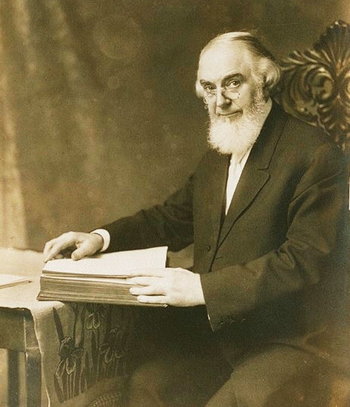
1914 in JW Eschatology
“We see no reason for changing the figures – nor could we change them if we would. They are, we believe, God’s dates, not ours. But bear in mind that the end of 1914 is not the date for the beginning, but the end of the time of trouble.”
Watchtower Magazine, April 15, 1894

Slide 60
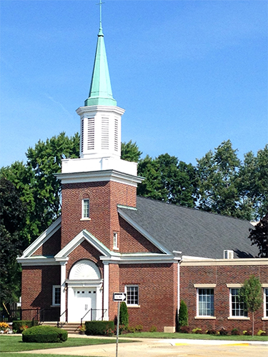
1918 in JW Eschatology
“In the year 1918, when God destroys the churches wholesale and the church members by millions, it shall be that any that escape shall come to the works of Pastor Russell to learn the meaning of the downfall of Christianity.”
The Finished Mystery (Studies in Scripture), Volume VII, page 485

Slide 61
1925 in JW Eschatology
In 1920, the Watchtower Society published Judge Rutherford’s booklet, Millions Now Living Will Never Die. On September 25, 1920, Rutherford began a public lecture program called the “Millions Campaign.”
“We may confidently expect that 1925 will mark the return of Abraham, Isaac, and Jacob and the faithful prophets of old, particularly those named by the Apostle in Hebrews chapter eleven, to the condition of human perfection.”
Millions Now Living Will Never Die!, pages 89-90

Slide 62
1975 in JW Eschatology
In the summer of 1966, Fred Franz published a book entitled Life Everlasting in Freedom of the Sons of God. Franz wrote on page 28, “According to this trustworthy Bible chronology (Ussher’s), six thousand years from man’s creation will end in 1975, and the seventh period of a thousand years of human history will begin in the fall of 1975 C.E.”
On February 10, 1975, VP Franz spoke to over 20,000 JW’s at the Los Angeles Sports Arena. Franz said that 6,000 years of human history would definitely end at sundown, September 5, 1975.

Slide 63
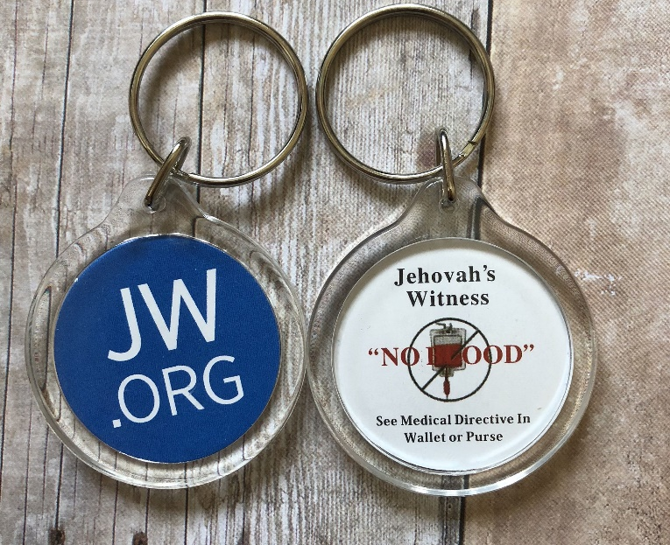
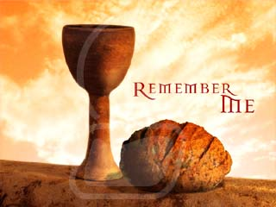
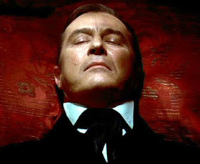
Distinctive JW Beliefs

Slide 64
Blood Transfusions
Leviticus 17:12-14 – “Therefore I said to the children of Israel, ‘No one among you shall eat blood, nor shall any stranger who dwells among you eat blood.’ Whatever man of the children of Israel, or of the strangers who dwell among you, who hunts and catches any animal or bird that may be eaten, he shall pour out its blood and cover it with dust; for it is the life of all flesh. Its blood sustains its life. Therefore I said to the children of Israel, ‘You shall not eat the blood of any flesh, for the life of all flesh is its blood. Whoever eats it shall be cut off.’”

Slide 65
Blood Transfusions
Blood transfusion refusals began in 1945.
“The society argued that accepting a transfusion was tantamount to eating blood.” Apocalypse Denied, page 284
Other verses include Genesis 9:3-4; Deuteronomy 12:23-25; Leviticus 7:26-27; Acts 15:28-29.
All of these verses prohibit the eating of animal blood, not the use of human blood for medical reasons. Remember Mark 7:15.
Interestingly, Orthodox Jews don’t refuse blood transfusions.

Slide 66
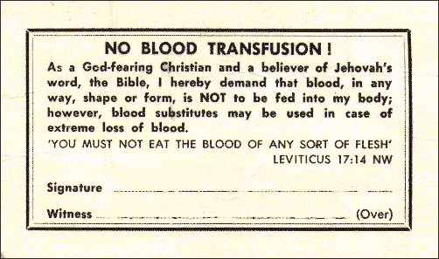

Blood Transfusions
“How could the Bible have been referring to this lifesaving medical procedure of blood transfusion, given that it didn’t even become possible until thousands of years after the Bible was written?” Getting Through to Jehovah’s Witnesses, page 277

Slide 67
JW’s and Communion
JW’s observe communion only once a year at special “Memorial Services” at the time of the Jewish Passover date. The next Memorial Service is Tuesday, April 7, 2020.
“Who, then, may properly partake of the Memorial emblems of the bread and wine? Those of the ‘other sheep’ class are not in the new covenant and so do not partake.” The Watchtower, February 15, 1986, pages 14-15
“This accounts for the vast majority of the Jehovah’s Witnesses being observers not partakers.”

Slide 68
Communion
David Reed, using JW statistics, reports that in 1994, 12,200,000 attended the memorial service worldwide, but only 8,617 partook of communion. These were “primarily elderly JWs baptized before the year 1935. The bread and the cup are passed up and down the aisles with no one taking communion.” Answering Jehovah’s Witnesses, page 84

Slide 69
Hell-Death-Soul Sleep
Russell’s parents, Joseph and Eliza, were “deeply religious” Presbyterians. Around 1868-1869, he was “deeply shaken” by the teaching on hell.
He couldn’t understand “how an all-loving God could punish sinners with the infinite torments of hellfire.” Apocalypse Denied, page 14
He rejected the Bible’s teaching on hell – It does not “teach the terrible doctrine of eternal torment.” Official Watchtower Biography, page 2
At death, only JW’s enter into soul sleep. All unbelievers are annihilated.

Slide 70
Hell-Death-Soul Sleep
Like the SDA church, JW’s believe in “soul sleep.” “The state of unconsciousness into which the soul of the Christian passes at death (until the return of Christ).” The Teachings of JW’s, page 23
Annihilationism – “There can be no punishment after death in the Jehovah’s Witness scheme of things because the dead cease to exist. They are gone, vanished without a trace. There is no soul or spirit remaining to experience punishment.” Answering Jehovah’s Witnesses, page 133
The 144,000 go to heaven; the “great crowd” inherits a paradise earth; non-JW’s cease to exist.

Slide 71
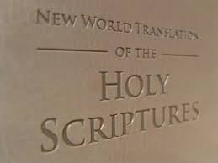
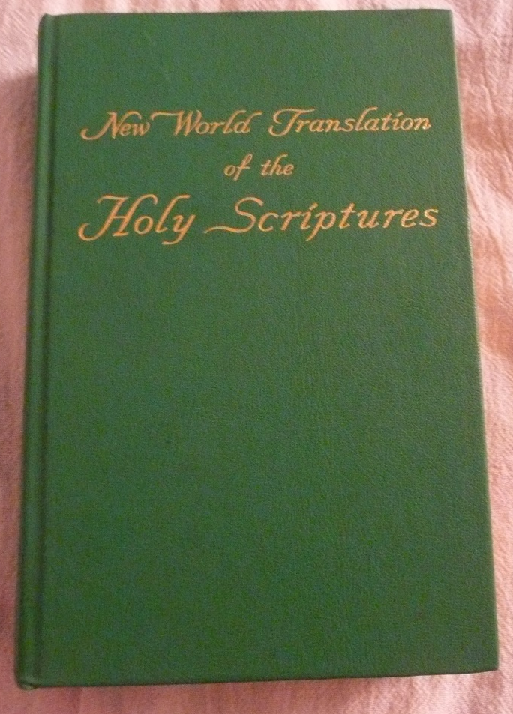
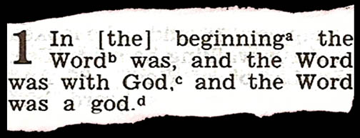
Revised New World Translation (RNWT)

Slide 72
RNWT
Up until 1950, the JW’s used the KJV. In 1950, they published the NWNT, and in 1960, the NWOT. Their complete version came out in 1961.
The translation team was Knorr, Franz, Schroeder, Gangas, and Menschel. None but Franz had any knowledge of Biblical languages, and Franz studied two years of biblical Greek, but never even completed an undergraduate degree.
The NWT is now in 185 languages, and major revisions were made in 1984 and 2013.
There are many books written against the NWT.

Slide 73
RNWT
“Jehovah” is used 237 times in their NT. Anywhere that the OT is quoted in the NT, anywhere that the “angel of the Lord,” or “word of the Lord,” or where Jesus might be considered God, is changed to “Jehovah.”
Revelation 1:8 – “I am the Alpha and the Omega, says Jehovah God, the One who is and who was and who is coming, the Almighty.”
Genesis 1:2 – “…God’s active force was moving about over the surface of the waters.”
Mark 1:8 – “I baptized you with water, but he will baptize you with holy spirit.” No “the” included.

Slide 74
RNWT
Matthew 1:18 – “…his mother Mary was promised in marriage to Joseph, she was found to be pregnant by holy spirit…”
Margin definition of the Spirit in John 16:13: “Jesus used ‘the helper’ (which has the masculine gender in Greek) as a personification of the holy spirit, an impersonal force.”
2 Corinthians 3:17-18 – “Now Jehovah is the Spirit, and where the spirit of Jehovah is, there is freedom…we are transformed into the same image from one degree of glory to another, exactly as it is done by Jehovah the Spirit.”

Slide 75
RNWT
They use “torture stake” for “cross.”
1 Corinthians 1:17-18 – “For Christ sent me, not to baptize, but to declare the good news; and not with wisdom of speech, so that the torture stake of the Christ should not be made useless. For the speech about the torture stake is foolishness to those who are perishing, but to us who are being saved, it is God’s power.”
Matthew 16:24 – “Then Jesus said to his disciples: ‘If anyone wants to come after me, let him disown himself and pick up his torture stake and keep following me.’”

Slide 76
RNWT
Why not use “cross?” The cross is the main symbol used by Christians. Bible translations used by Christians are corrupt; thus, the RNWT corrects verses mistranslated in other Bibles.
It is so much easier to convince the unsuspecting of their doctrines when they use a translation that has been carefully written to support all their beliefs.
Reed writes, “It will be much easier to teach Watchtower doctrine using this unique translation. Why? Because hundreds of verses have been altered to facilitate that task.” (Page 170)

Slide 77

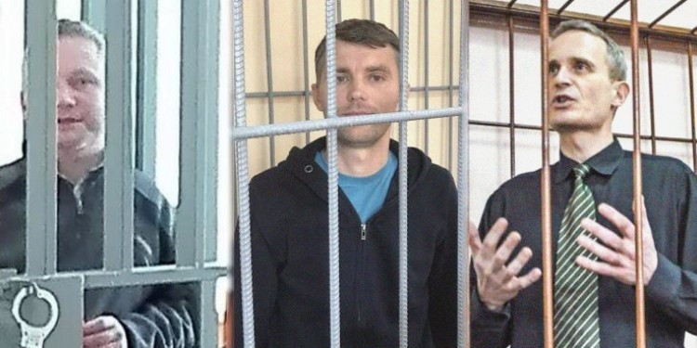
Governments & JW’s Persecution

Slide 78
JW Government Beliefs
JW’s refuse to salute the flag (1935) or say the pledge of allegiance. It is never used in their homes and Kingdom halls – not even stamps with flags are used! It is considered pagan and idolatrous.
They are not allowed to sing the national anthem of the nation where they reside.
JW’s are not allowed to engage in politics or serve in the military. They cannot hold public office. They cannot be involved in fighting in a war.
JW’s are not allowed to vote. Voting will get you disfellowshipped from the Watchtower Society.

Slide 79
JW Government Beliefs
Raymond Franz in Crisis of Conscience writes of two cases that could get a JW disfellowshipped.
“The case of a wife who had a non-Witness husband in military service and she worked in a commissary on her husband’s military base.” (Page 99)
The case of a JW “driving a truck for the Cola-Cola Company, had as his route a large military base where numerous deliveries were made.” (Page 98)
Unless the wife quit the commissary job and the driver got a new route or quit, both situations merited being booted from the Watchtower Society.

Slide 80
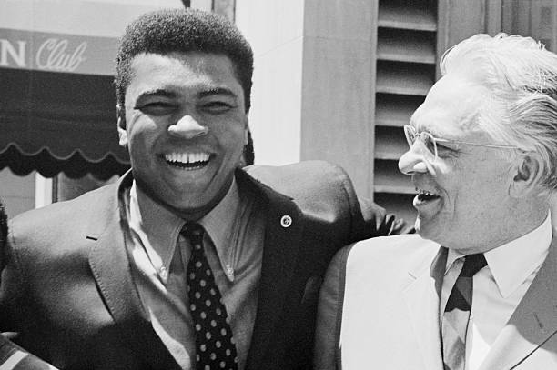
JW Government Beliefs
“Between 1933 and 1951 there were 18,866 arrests of American Witnesses and about 1,500 cases of mob violence against them.” (Penton, page 117)
“Between 1938 and 1955 they were to fight a total of forty-six cases before the Supreme Court and were to win thirty-six.”
Hayden Covington, Victor Blackwell, W. Glen How were attorneys who helped JW’s.

Slide 81
JW Persecution
JW’s have been imprisoned, beaten, and killed in Poland, Czechoslovakia, Hungary, Malawi, Mozambique, Canada, China, Cuba, and the former Soviet Union, East Germany, and Romania.
The Nazi regime sent many JW’s to concentration camps. The Dominican Republic under the dictator Trujillo banned all JW activity and in 1957 expelled all American JW missionaries.
In the minds of JW’s worldwide, this persecution by worldly, secular governments only further confirmed their beliefs that they were God’s organization and they were being persecuted for Jehovah’s sake.

Slide 82
JW Government Beliefs
Why? Why did they not salute the flag, not serve in the military, not vote, and oppose politicians?
Because they saw all secular governments as part of Satan’s dominion.
The verse they used repeatedly was 1 John 5:19, “We know that we originate with God, but the whole world is lying in the power of the wicked one.” NWT
ERV – “We know that we belong to God, but the Evil One controls the whole world.”
They also use John 6:15 when Jesus was going to be taken by force as king and Acts 5:29.

Slide 84
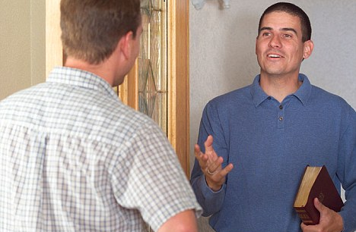
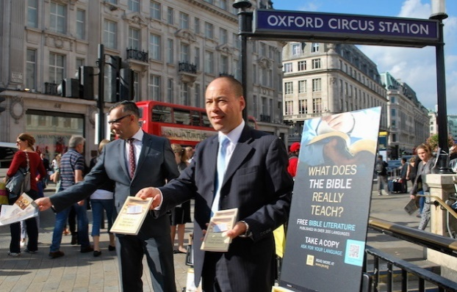
Session 3
Witnessing to Jehovah’s Witnesses

Slide 85
Reminder
“The Devil is the great enemy or adversary of God, and his religion therefore is an enemy of Almighty God. The Devil is man’s worst enemy, and his religion is likewise a deadly enemy to man. The Devil’s Organization is symbolized by an unchaste and impure woman, which is called ‘Babylon.’ Therefore all religions are of Babylon, and particularly the leading religion known in the lands as ‘Christendom.’”
From the Watchtower Society book called Enemies, page 71, paragraph 1.

Slide 86
Reminder
The JW sees you (the Christian) as part of the devil’s organization.
The JW sees you as lost. You must be rescued.
The JW sees himself as the teacher. The JW must teach you.
The JW sees himself as the sole possessor of truth. You believe and live lies.
The JW sees the Watchtower Society as God’s ONLY organization. All other religions and faiths are false. The Watchtower and its GB are the ONLY authorized interpreters of biblical truth.

Slide 87
The Holy Spirit & Prayer
You are dealing with doctrines of demons and spiritual enslavement of the worst kind.
The wisdom and power of the Holy Spirit are far more powerful than the deceptions of the devil.
Anton LaVey was better off than a JW; for at least he knew he was serving the devil!
Pray for open doors; pray for scales to fall from JW’s eyes; pray for boldness and clarity of speech.
It’s not just about the proper technique, historical information, or correct biblical interpretation.

Slide 88
Where Will You Engage Them?
2 John 10-11 – “If someone comes to you and does not bring this teaching (doctrine), do not welcome or accept that person into your house. If you welcome such a person, you share in the evil work.” (NCV)
2 John 11 – “Greeting them is the same as taking part in their evil deeds.” (CEV)

Slide 89
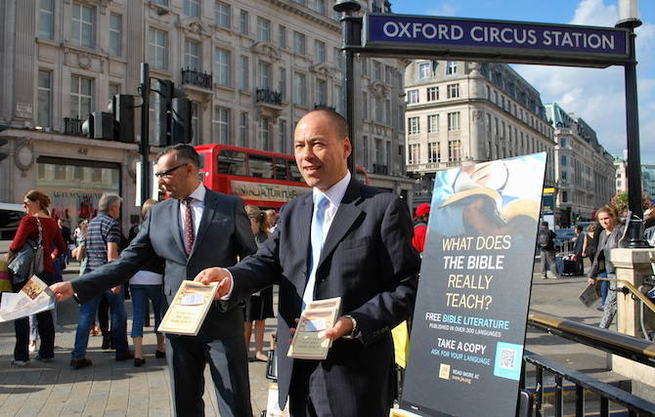
Where Will You Engage Them?
In the “highways and hedges” – On college campuses, beaches, bus stops, malls, crowded intersections.
JW’s who are Family.
JW’s who are disillusioned.
If they come to your door, let them stay outside. Don’t invite them in.

Slide 90
How NOT to Witness
“The Watchtower leadership has instructed JW’s not to listen to Christians who want to tell them about Jesus, not to debate doctrine with knowledgeable members of other churches, and not to read literature critical of the organization or its beliefs. On the other hand, they are trained to answer people’s questions and to help people who need information. So, if you try to tell a JW why his beliefs are wrong and yours are right, you will encounter fierce resistance.”
David Reed, Answering Jehovah’s Witnesses, page 12

Slide 91
How NOT to Witness
“If you ask for help and rephrase your arguments to present the same evidence in the form of questions, you will be able to accomplish a lot more. Work with the JW’s brainwashing instead of against it.” Reed, page 12
Be an active (not passive), questioning student. Whoever asks the questions, controls the conversation. They have been trained to take you down planned, prepared paths that work in their favor. Don’t let them do that.
You are the student. You ask the questions.

Slide 92
The Watchtower Society
“Again and again I saw evidence of one underlying idea that governs the life of a Jehovah’s Witness: Jehovah God works through one and only one organization today – the Watchtower Society. Devotion to that concept is what makes a person a Jehovah’s Witness. This organizational mindset dominates every aspect of their minds, hearts, and lives.”
David Englund, Getting Through to Jehovah’s Witnesses, page 24

Slide 93
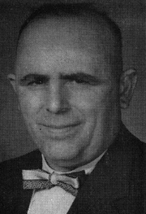
The Watchtower Society
JW’s have “surrendered all individualism, abandoned all personal thinking, and given up all private initiative.” (Page 23)
“Personal freedom was replaced by blind loyalty to the Watchtower directives.” (Page 30)
“The second phase of brainwashing, namely, the annihilation of individuality into robot-like mass action.” (Page 36)
William Schnell, 30 Years a Watchtower Slave

Slide 94
How NOT to Witness
Do not directly attack, argue, or get angry with a JW. This only reinforces their beliefs.
Do not immediately call them a cult group, false prophets, or the devil’s organization. Do not tell them that they are going to hell.
Do not immediately begin to present arguments in favor of the Trinity or the deity of Jesus Christ.
Do not show them “apostate literature” or books by ex-Jehovah’s Witnesses.
Do not insult, mock, ridicule, or laugh at them.
Remember Col 4:6, 1 Peter 3:15, 2 Timothy 2:24-26.

Slide 95
How to Witness
Don’t argue, ASK QUESTIONS. Let them be the teacher that answers YOUR questions.
Don’t argue, “UNDERMINE the JW’s confidence in the Watchtower organization by revealing its prophetic failures, doctrinal flip-flops, and dishonest cover-ups.”
Reed, Answering Jehovah’s Witnesses, page 13

Slide 96
Keep It Simple
Suppose a JW comes to your house, and begins telling you about the Watchtower Society and if he can do a free home Bible Study.
“I don’t have time right now, but let me tell you a brief testimony of what Jesus did in my life in…”
“In fact, just two weeks ago, I was praying to the Lord Jesus, and he gave me that job that I was hoping for. Jesus is so good to me.”
“Now, can you tell me a recent testimony of how Jesus has answered your prayers?”
“I’m going to pray for you this evening.”

Slide 97
False Prophecies
Why did Charles Russell clearly predict that in 1914 there would be a final end of the kingdoms of this world, and the full establishment of the Kingdom of God? This did not happen.
Why did the Watchtower Society openly predict that in 1918 God would destroy the churches wholesale and the church members by the millions? This did not happen.
Why did Judge Rutherford write a book and the Watchtower Society begin preaching in 1920 that the year 1925 would bring the Millennium? This did not happen.

Slide 98
False Prophecies
Why did the Watchtower Society acquire property and build a San Diego mansion (Beth Sarim) in 1930 as a house for David, Gideon, Barak, Samson, Jephthah, Joseph, and Samuel, 7 “Ancient Worthies” who would be “Earth’s new rulers” within a few years? This never happened. The mansion and property were sold in 1948.
Why did Frederick Franz, the Watchtower theologian, predict in a book in 1966 and later address 20,000 JW’s in Los Angeles that 6,000 years of human history would end on Sept 5, 1975, and that Christ’s millennial rule would begin? This never happened.

Slide 99
Doctrinal Flip-Flops
Why did the Watchtower Society teach in 1904 that Romans 13:1-7 speaks of secular rulers/govts and that they should be obeyed, but in 1929, Judge Rutherford said that the “higher powers” were “Jehovah God and Jesus Christ,” and that all secular rulers and governments were of the devil? Even in 1959, the Watchtower wrote that the previous view needed to be strongly condemned because it was “false doctrines and practices” that had to be “cleaned out of the organization.” Then, in 1962, the Watchtower said that the “higher powers” were the secular rulers and governments.

Slide 100
Flip-Flops
Why did the Watchtower Society ban organ transplants (including cornea transplants) as cannibalism in 1967, repeat the ban in 1968, but then in 1980 dropped the organ transplant ban? Between 1967-1980, many JW’s went blind or died as a result of this policy that the Watchtower said for 13 years violated God’s law.
Why did the Watchtower Society ban vaccinations in 1931 as a “direct violation of the everlasting covenant with God,” then dropped the ban in 1952? Did Jehovah change his mind? If not, then why did the Watchtower change their position?

Slide 101
Conflicted Teaching
Revelation 7:9 – “After this I saw, and look! a great crowd, which no man was able to number, out of all nations and tribes and peoples and tongues, standing before the throne and before the Lamb, dressed in white robes; and there were palm branches in their hands.”
Why did the Watchtower Society (Judge Rutherford) begin teaching in 1935, that there were two different classes of believers – the 144,000 (heavenly) and the “great crowd” (earthly), when the “great crowd” as seen in Revelation 7:9 is in heaven “standing before the throne of God?”

Slide 102
The Holy Spirit
JW’s believe that the Holy Spirit is an active, impersonal force. JW’s are taught that He is not a person nor that He is divine (Trinity).
Genesis 1:2 – “God’s active force was moving about over the surface of the waters.” (RNWT)
Genesis 1:2 – “The Spirit of God was hovering over the face of the waters.” (NKJV)
“What do you believe about the devil? Do you believe that the devil is a real angelic spirit person? He’s not a ‘force’ like in Star Wars, is he?”
“Can we look at some verses in Acts on the Holy Spirit in your Bible?”

Slide 103
The Holy Spirit
Acts 13:2, 4 – “As they were ministering to Jehovah and fasting, the holy spirit said: ‘Set aside for me Barnabas and Saul for the work to which I have called them.’ So these men, sent out by the holy spirit, went down to Seleucia.” (RNWT)
Acts 10:19-20 – “As Peter was still pondering over the vision, the spirit said: ‘Look! Three men are asking for you. So get up, go downstairs and go with them, not doubting at all, because I have sent them.’”
Acts 8:29 – “So the spirit said to Philip: ‘Go over and approach this chariot.’” (RNWT)

Slide 104
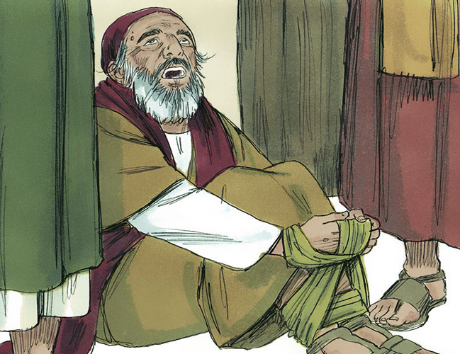
The Holy Spirit
Acts 21:11 – “A prophet named Agabus came down from Judea. And he came to us and took Paul’s belt and tied his own feet and hands and said: ‘Thus says the holy spirit, The man to whom this belt belongs will be bound like this by the Jews in Jerusalem, and they will give him into the hands of people of the nations.’” (RNWT)

Slide 105
The Holy Spirit
Acts 5:3-4 – “But Peter said: ‘Ananias, why has Satan emboldened you to lie to the holy spirit and secretly hold back some of the price of the field? You have lied, not to men, but to God.’” (RNWT)
John 16:13-14 – “However, when that one comes, the spirit of the truth, he will guide you into all the truth, for he will not speak of his own initiative, but what he hears he will speak, and he will declare to you the things to come. That one will glorify me, because he will receive from what is mine and will declare it to you.” (RNWT)

Slide 106
Jesus as God in RNWT
Why did the Jews try to kill Jesus in John 5:18 because “he was also calling God his own Father, making himself equal to God?”
Why does Thomas call Jesus in John 20:28, “My Lord and my God!”
Why does Isaiah 9:6 in the RNWT, a prophecy clearly referring to Jesus, call Him, “Wonderful Counselor, Mighty God, Eternal Father, and Prince of Peace?”
Why does 1 John 5:20 say clearly that “his Son Jesus Christ…This is the true God and life everlasting.”

Slide 107
Jesus as God in RNWT
Why does Hebrews 1:3 say that Jesus is “the exact representation of his (God’s) very being” and 1:8 say that the “Son” is “God” and that His “throne is forever and ever?” Why does Hebrews 1:10 show that Jesus is the “Lord” who “laid the foundations of the earth, and the heavens are the works of your hands?”
Why is Jesus called “Immanuel” in Matthew 1:23, which means in Hebrew, “God with us?” This is a quote from Isaiah 7:14.
All the verses that clearly speak of Jesus as God have been altered. They add the words “of” or “the” to change “our God and Savior, Jesus Christ.” 2 not 1.

Slide 108
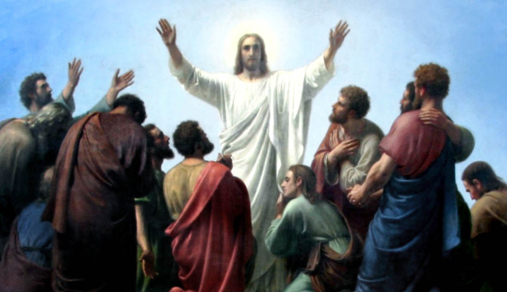
Jesus Worshipped
Look at the separate 2-page handout that you received.
RNWT changes all the words from “worship” to “obeisance” WHEN IT INVOLVES JESUS.
BUT, the same Greek word is translated “worship” when it involves Father God or God or Jehovah! Clearly, a biased translation.

Slide 109


Recommended Books

Slide 110
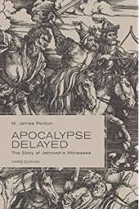
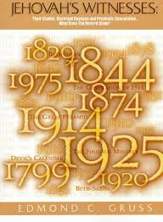
More Detailed Studies

Slide 111

Helpful Websites
www.towerwatch.com
www.avoidjw.org
www.answerJW.com
www.DAEnglund.com
(The Jehovah’s Witnesses main website is www.jw.org)

