Slide 2
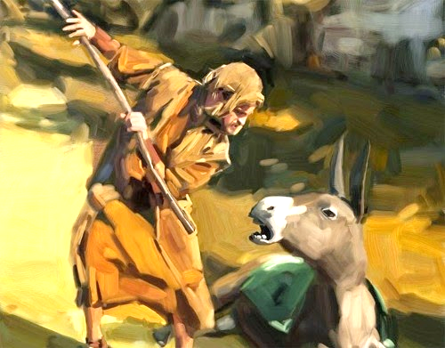
Balaam – The Prototype False Prophet
www.teacherofthebible.com

Slide 3

Who is this?

Slide 4

Who is this?

Slide 5

Prototype False Prophet
Balaam

Slide 6
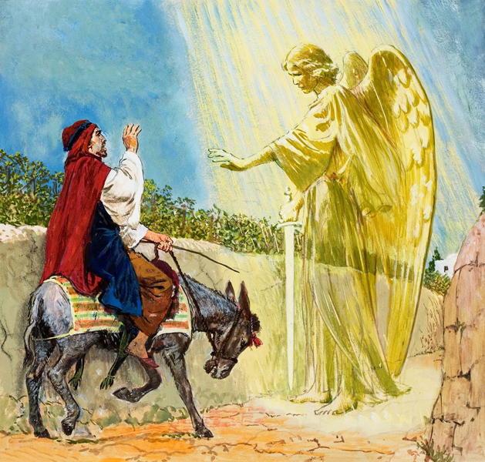
The Prototype False Prophet
“Proto” means “first; beginning; primary.”
“Tupos” means “example; sample; standard.”
The original model that has all the essential features of all subsequent models.

Slide 7
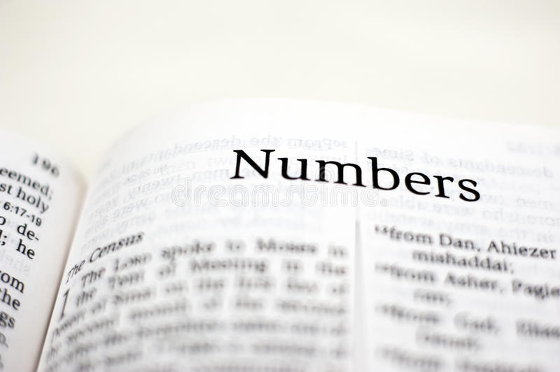
Numbers 22-25

Slide 8
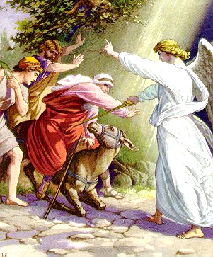
Balaam in the New Testament
2 Peter
Jude
Revelation

Slide 9
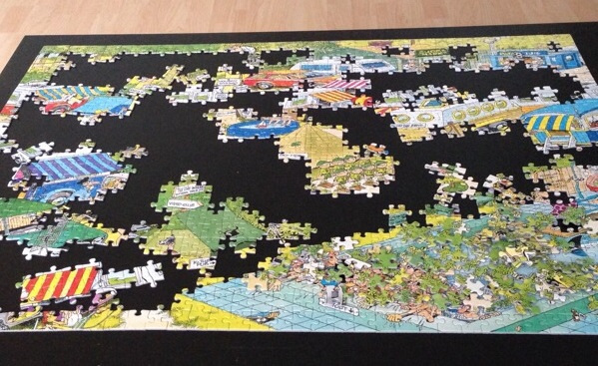
The Puzzle Pieces

Slide 10
Balaam – Who was he?
We are told he was a “SOOTHSAYER” and a “prophet.”

Slide 11
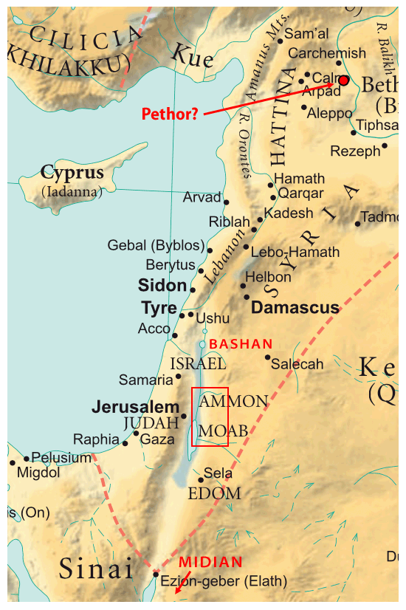
Pethor of Mesopotamia

Slide 12
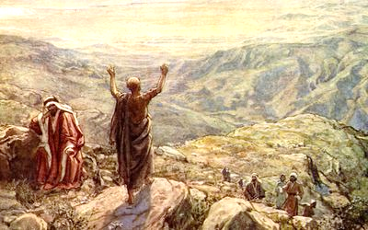
Balaam – Sinner or Saint?
He sounds like a GENUINE PROPHET of God.

Slide 13
Numbers 24:3-4
“Then he took up his oracle and said: ‘The utterance of Balaam the son of Beor, the utterance of the man whose eyes are opened, the utterance of him who hears the words of God, who sees the vision of the Almighty, who falls down, with eyes wide open.’”

Slide 14
Not a Concluding Verse!!!
Numbers 24:25 – “So Balaam rose and departed and returned to his place; Balak also went his way.”

Slide 15
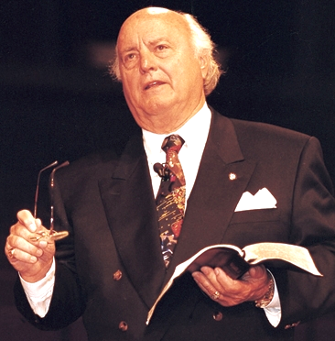
Dr. Ed Cole Quote
“Don’t touch the GOLD, don’t touch the GLORY, and don’t touch the GIRLS!”
The 3 G’s.

Slide 16
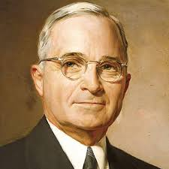
Harry Truman Quote
3 Things Ruin a Man:
Power
Money
Women

Slide 17
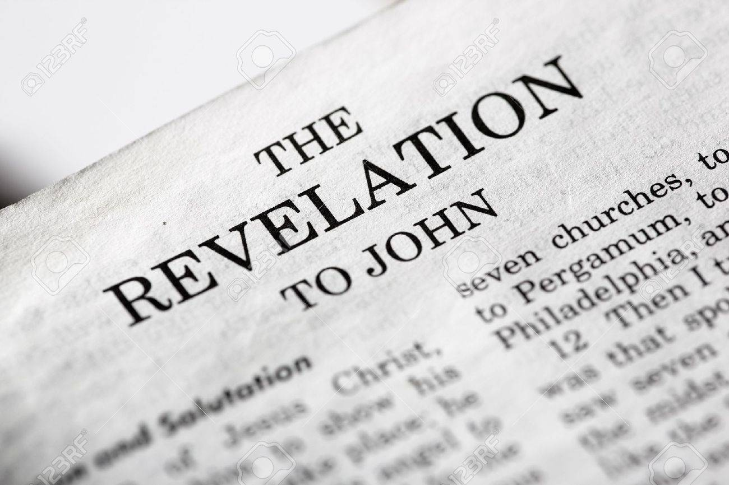
Balaam – What did he do?
Revelation 2:14

Slide 18
Numbers 25:1
“While Israel was staying in Shittim, the men began to indulge in SEXUAL IMMORALITY with Moabite women.”

Slide 19
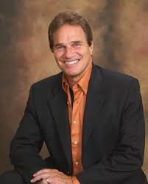

Terry Macalmon

Slide 20


Terry Macalmon

Slide 21


Carl Lentz – Hillsong NYC

Slide 22
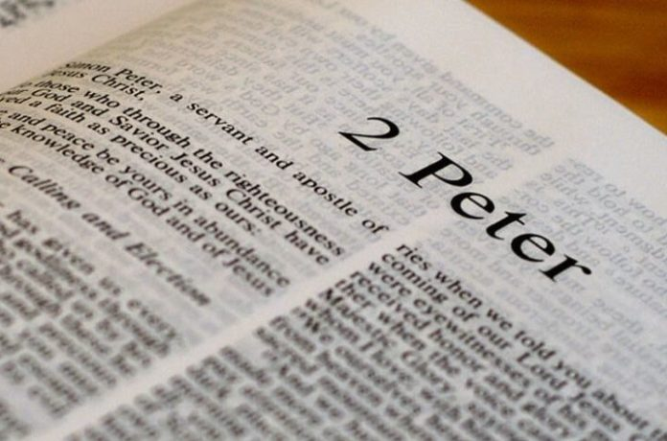
Scripture
2 Peter 2:15-16

Slide 23
Jude 11
“Woe to them! For they have gone in the way of Cain, have run greedily in the error of Balaam FOR PROFIT, and perished in the rebellion of Korah.”

Slide 24
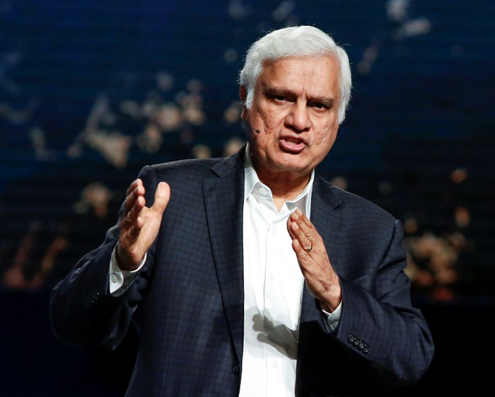
Ravi Zacharias

Slide 25
Scripture
Numbers 22:22-35

Slide 26
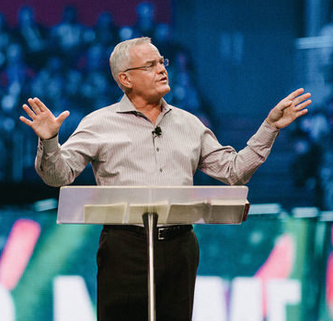
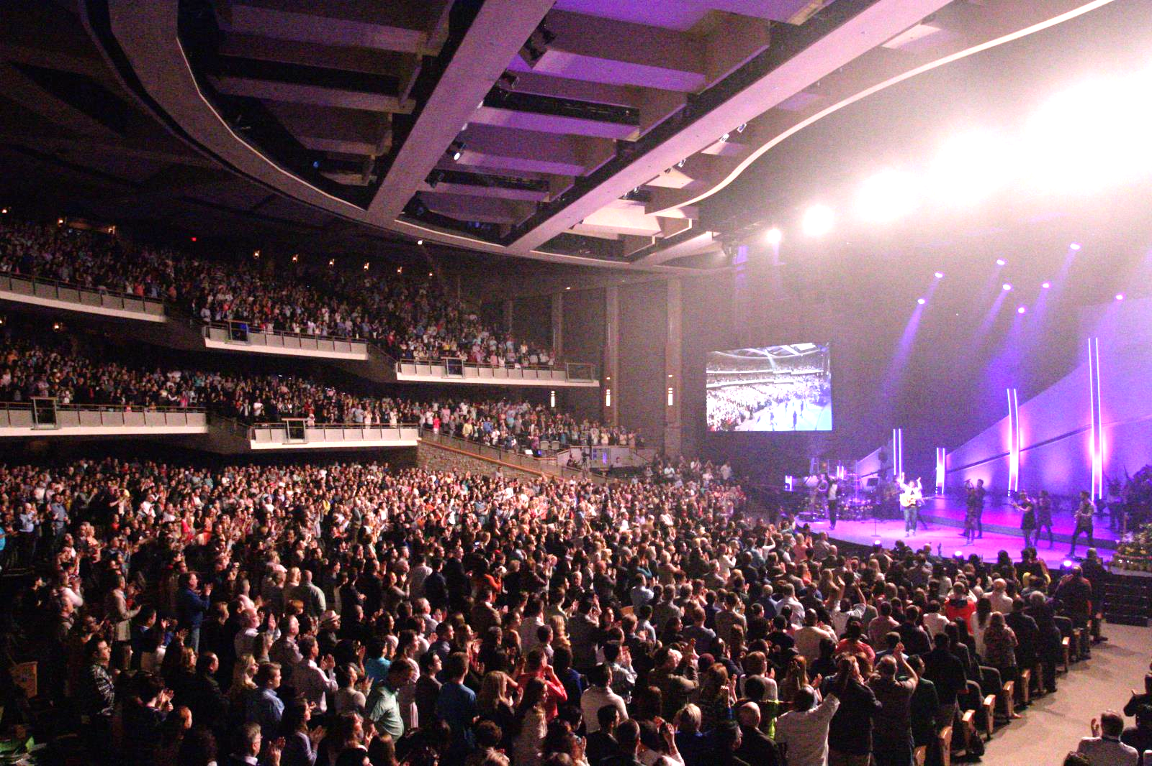
Pastor Bill Hybels

Slide 27


Pastor Ted Haggard

Slide 28
Numbers 31:8
“Balaam the son of Beor they also killed WITH THE SWORD.”

Slide 29
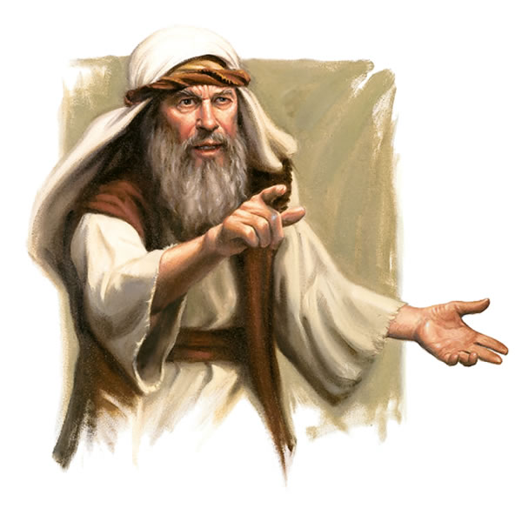
Next Class
Jeremiah and the False Prophets

