Slide 1
YouTube Seminar

Slide 3
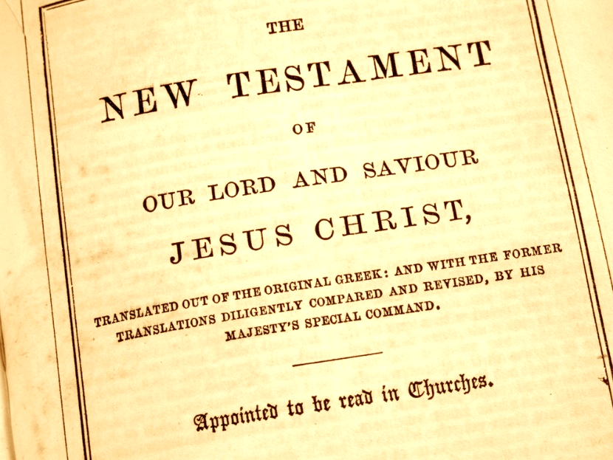
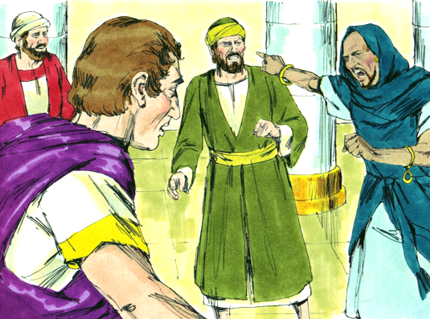
Witchcraft in the New Testament

Slide 4
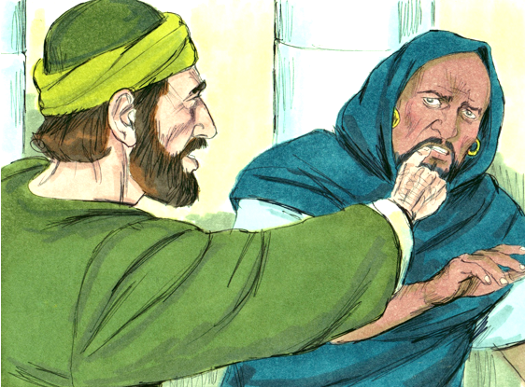
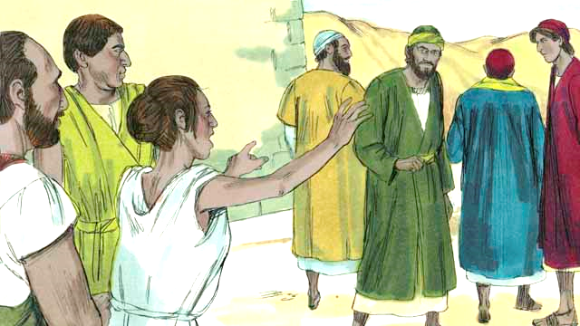
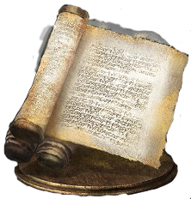
The Bible & Witchcraft

Slide 6
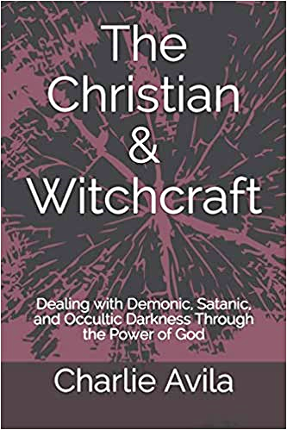
The Christian & Witchcraft
Session #1
Rosie the Spiritual Guide

Slide 7
An Educated Nurse

Slide 8
Attack of the Fingernails!

Slide 9
Rosie & the Roses

Slide 10
Next Teaching
Simon the Sorcerer – Acts 8

Slide 12
The Christian & Witchcraft
Session #2
Simon the Sorcerer – Acts 8

Slide 13
Scripture
Acts 8:9-13
Acts 8:18-24

Slide 14
Peter Rebukes Simon

Slide 15
Next Teaching
The Wizard of Indiana

Slide 17
The Christian & Witchcraft
Session #3
The Wizard of Indiana

Slide 18
Wizard of Westwood

Slide 19
A Wizard from Indiana

Slide 20
From Pastor to Frog!!!

Slide 21
Billy Graham

Slide 22
Next Teaching
Elymas the Sorcerer – Acts 13

Slide 24
The Christian & Witchcraft
Session #4
Elymas the Sorcerer – Acts 13

Slide 25
Scripture
Acts 13:4-12

Slide 26
Pat Longo – Theresa Caputo

Slide 27
From Her Website
“My name is Pat Longo and I have been blessed with the extraordinary ability to heal others by using the power of Divine energy. For over 20 years, I have had the privilege of being instrumental in the miraculous healings of countless men, women, and children. I have been given the capability to channel Universal Energy with pure light and love through my hands to restore, correct, and transform energetic imbalances within my client’s energy fields.”

Slide 28
From Her Website
…As a result, Pat immediately found herself in a class that taught Spiritual Awareness. Within 3 short weeks, her hands began to heat up and her God-given gift of healing had presented itself. She realized that this was the job God meant for her to do. Meditation began to open her students up to their spiritual gifts. Pat’s worldwide mentoring has enabled many more psychics, mediums, teachers, and healers to move forward with their gifts to help and heal others.”

Slide 29
Elymas Blinded

Slide 30
Next Teaching
Women and the Psychic Connection

Slide 32
The Christian & Witchcraft
Session #5
Women and the Psychic Connection

Slide 33
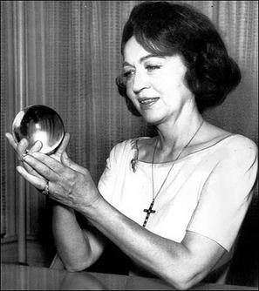
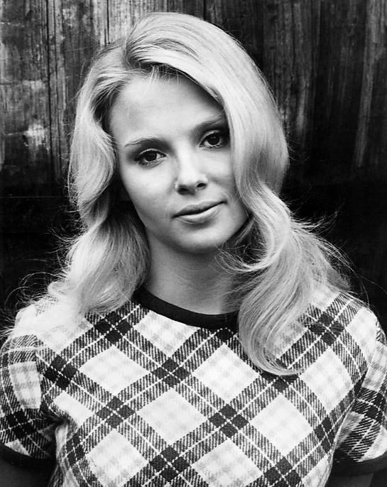
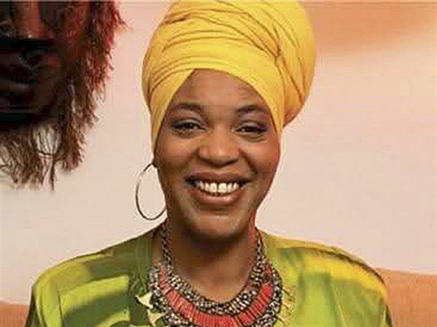

Slide 34
Joan Quigley

Slide 35
French President Francois Mitterrand

Slide 36
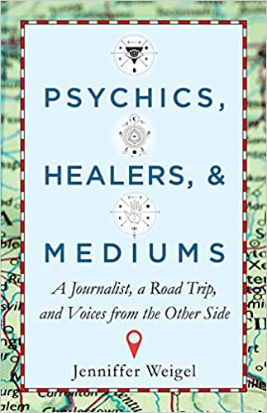
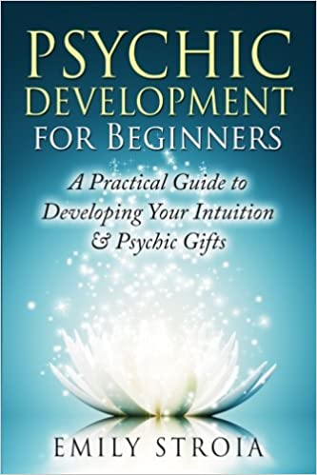
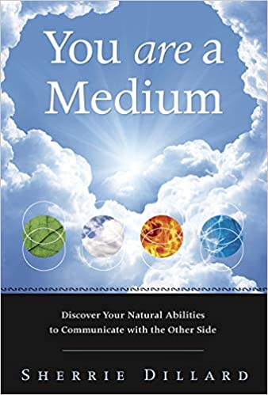
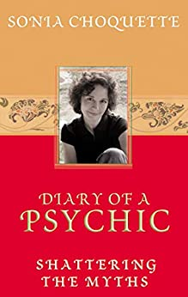
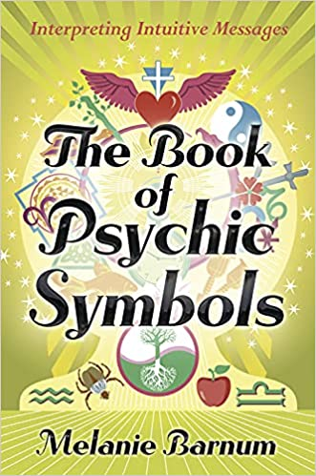

Slide 37
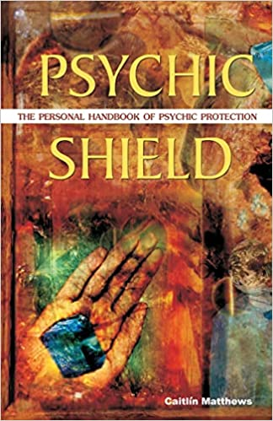
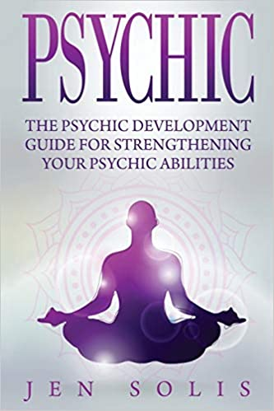
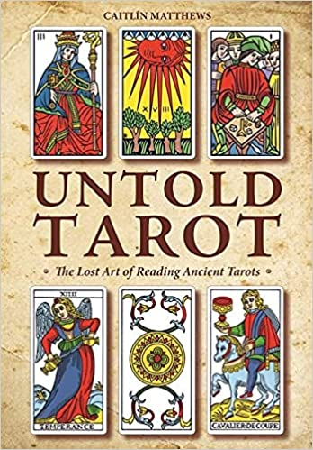
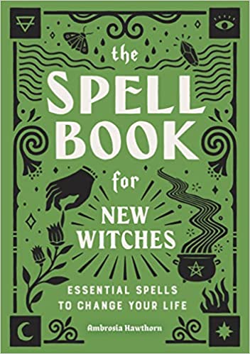

Slide 38
Jezebel
2 Kings 9:22 – “When Joram saw Jehu he asked, ‘Have you come in peace, Jehu?’ ‘How can there be peace,’ Jehu replied, ‘as long as all the idolatry and witchcraft of your mother Jezebel abound?’”

Slide 39
Energy Gemstones & Crystals

Slide 40
Next Teaching
A Fortune-Telling Slave Girl – Acts 16

Slide 42
The Christian & Witchcraft
Session #6
The Fortune-Telling Slave Girl – Acts 16

Slide 43
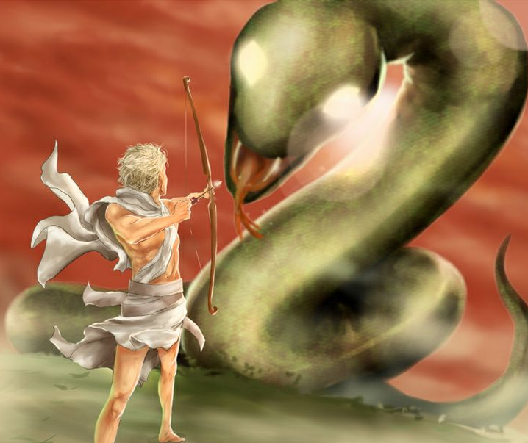
Puthon the Serpent killed by Apollo at Delphi

Slide 44
Scripture
Acts 16:16-24

Slide 45
Fortune-Tellers are Demonic

Slide 46
Next Teaching
Burning Sorcery Scrolls in Ephesus –
Acts 19

Slide 48
The Christian & Witchcraft
Session #7
Burning Sorcery Scrolls in Ephesus – Acts 19

Slide 49
The Book of Ephesians
“The prince of the power of the air, the spirit who works in the sons of disobedience.”
“The principalities and powers in heavenly places.”
“Don’t give place to the devil,” “the works of darkness,” “the wiles of the devil,” and “the fiery darts of the wicked one.”
We are “not wrestling against flesh and blood, but against principalities, against powers, against the rulers of the darkness of this age, against spiritual hosts of wickedness in the heavenly places.”

Slide 50
Scripture
Acts 19:11-20

Slide 51
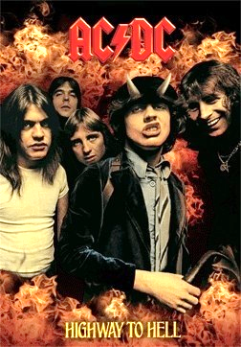
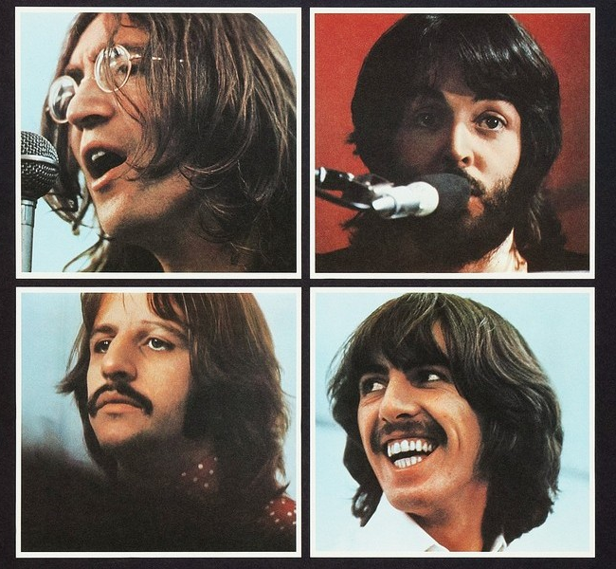
Albums & CDs

Slide 52
Chinese Dragons & Derek Prince

Slide 53
Next Teaching
A Final Word – New Testament

Slide 55
The Christian & Witchcraft
Session #8
A Final Word

Slide 56
Scripture
Galatians 5:20
Revelation 9:21
Revelation 18:23-24
Revelation 21:8, 22:15

Slide 57
Prayer

Slide 58
Next Teaching
The Porcelain Buddha

Slide 60
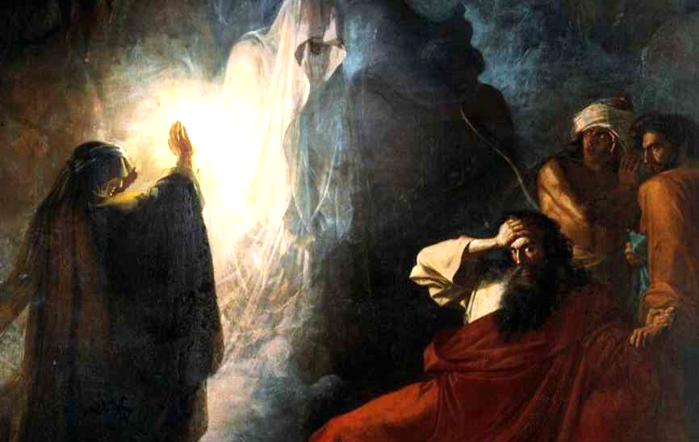
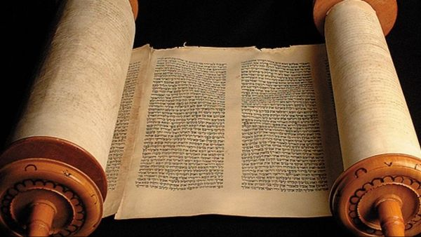
Witchcraft in the Old Testament

Slide 61
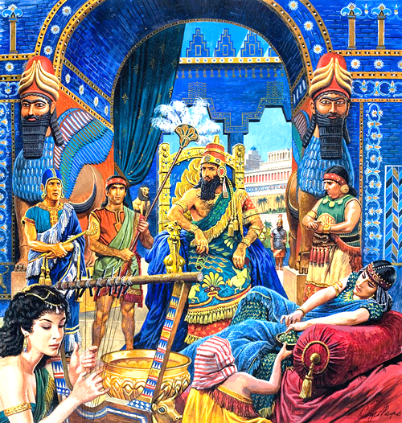
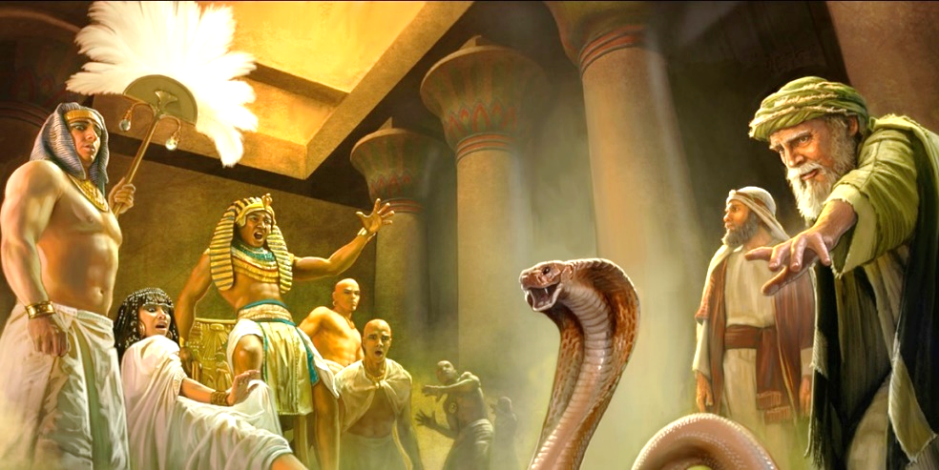
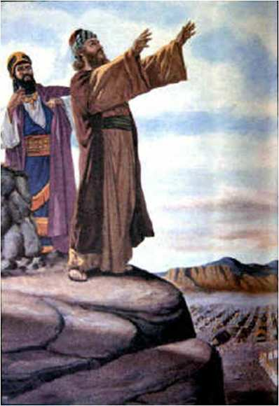
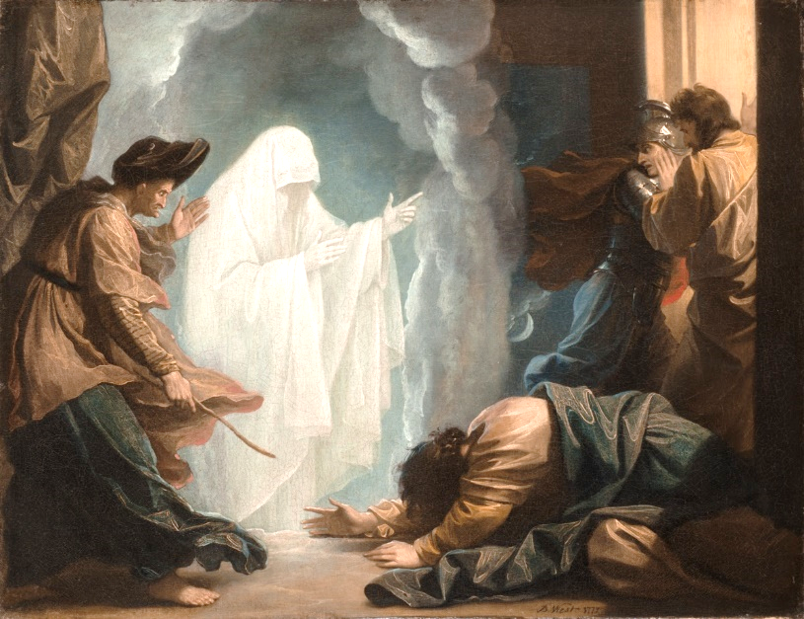
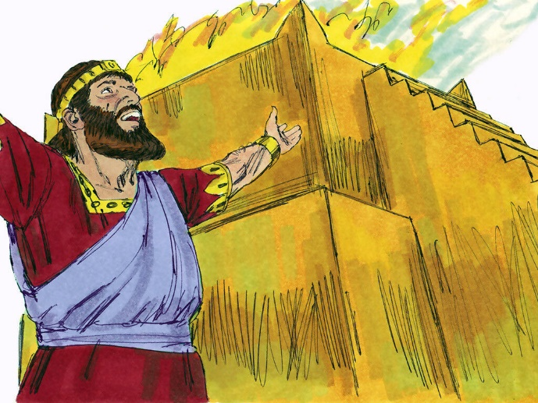
The Bible & Witchcraft

Slide 62
Many Different Hebrew Words
“Wizards,” “mediums,” “spiritists,” “psychics,” “necromancers,” “sorcerers,” “enchanters,” “witches,” “soothsayers,” “diviners,” “magicians,” “astrologers,” “observer of times,” and those with “familiar spirits.”

Slide 63
The Christian & Witchcraft
Session #9
The Porcelain Buddha

Slide 64
Porcelain Buddha

Slide 65
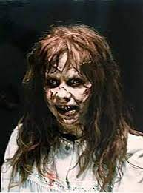
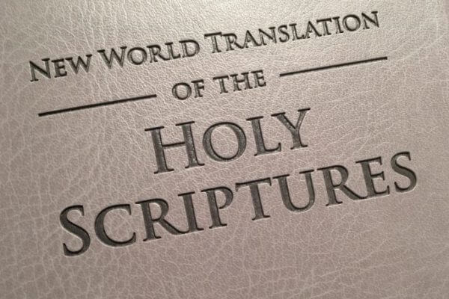
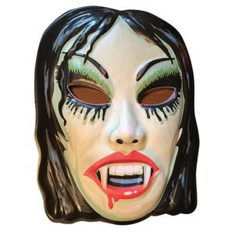
Next Teaching
Cursed Objects

Slide 67
The Christian & Witchcraft
Session #10
Cursed Objects

Slide 68
Scripture
Deuteronomy 7:25-26

Slide 69
Cursed Objects
Books, music, movies, religious candles, Indian jewelry, tarot cards, Ouija boards, cult books, bongs, drugs, games, crystals, dream catchers, statues, amulets, and other paraphernalia.
Don’t bring anything into your house that God hates. It is an abomination. God hates it. Don’t make God angry.
Whatever is an abomination to God must be an abomination to us. You must hate what God hates.

Slide 70
Next Teaching
Dream Catchers and the Little Girl

Slide 72
The Christian & Witchcraft
Session #11
Dream Catchers and the Little Girl

Slide 73
Dream Catchers

Slide 74
Native American Indian Curses

Slide 75
Iktomi Children’s Books

Slide 76
Next Teaching
Those Who Practice the Occult

Slide 78
The Christian & Witchcraft
Session #12
Those Who Practice the Occult

Slide 79
Scripture
Deuteronomy 18:9-19

Slide 80
The Occult List
“One who practices witchcraft”
“Soothsayer”
“One who interprets omens”
“Sorcerer”
“Conjures spells”
“Medium”
“Spiritist”
“One who calls up the dead (necromancer)”

Slide 81
Next Teaching
Halloween Paraphernalia

Slide 83
The Christian & Witchcraft
Session #13
Halloween Paraphernalia

Slide 84
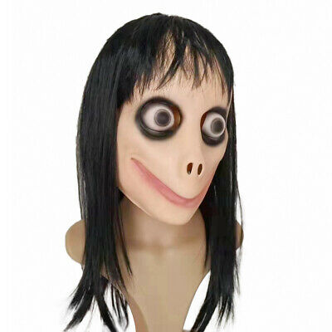
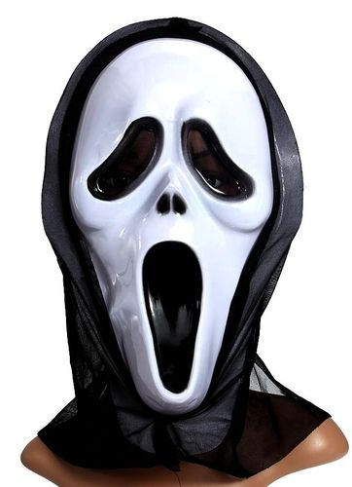
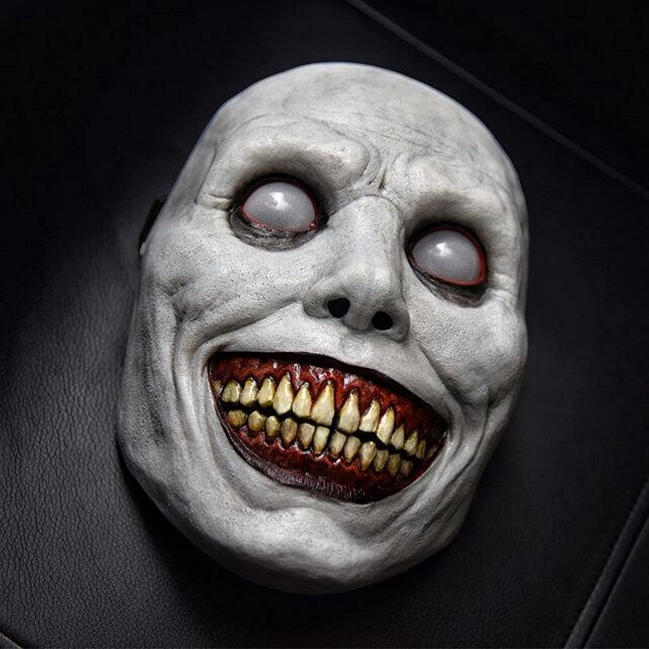
Halloween

Slide 85
Bad Movies

Slide 86
Documentaries, Violence, Rape
Proverbs 6:18 – “These things the Lord hates…an heart that devises wicked imaginations (schemes).”

Slide 87
Next Teaching
Witchcraft Defiles

Slide 89
The Christian & Witchcraft
Session #14
Witchcraft Defiles

Slide 90
Scripture
Leviticus 19:26, 31

Slide 91
Isaiah 8:19-20
“And when they say to you, ‘Seek those who are mediums and wizards, who whisper and mutter,’ should not a people seek their God? Should they seek the dead on behalf of the living? To the law and to the testimony! If they do not speak according to this word, it is because there is no light in them.”

Slide 92
Scripture
Leviticus 20:6-7
1 Corinthians 2:10-11 – “For the Spirit searches all things, yes, the deep things of God. Even so no one knows the things of God except the Spirit of God.”

Slide 93
Scripture
Leviticus 20:27

Slide 94
Next Teaching
Pornography and Violent Videos

Slide 96
The Christian & Witchcraft
Session #15
Pornography and Violent Videos

Slide 97
Pornography – A Spiritual Killer

Slide 98
Violent Video Games

Slide 99
Next Teaching
King Saul and the Witch at Endor

Slide 101
The Christian & Witchcraft
Session #16
King Saul and the Witch at Endor

Slide 102
Scripture
1 Samuel 28

Slide 103
A Word of Advice
Never consult anyone who practices witchcraft. Never. Ever. No tarot cards. No Ouija boards. No horoscopes. No psychics, wizards, palm readers, or sorcerers. Anything and everything associated with witchcraft will bring a curse into your life. You are playing with fire and you will be burned. Demons are involved and they will put a terrible hook in your jaw that will hold you captive for many years to come. Go to Jesus Christ. Go to the Word of God. Go to the light, not the darkness!

Slide 104
Next Teaching
Evil Objects, Books, Artifacts, and Symbols

Slide 106
The Christian & Witchcraft
Session #17
Evil Objects, Books, Artifacts, and Symbols

Slide 107
Scripture
1 Timothy 2:5 – “For there is one God and one Mediator between God and men, the Man Christ Jesus.”
Exodus 20:4 – “You shall not make for yourself a carved image – any likeness of anything that is in heaven above, or that is in the earth beneath, or that is in the water under the earth.”

Slide 108
Burn with Fire
Deuteronomy 7:5 – “Thus you shall deal with them: you shall destroy their altars, and break down their sacred pillars, and cut down their wooden images, and burn their carved images with fire.”

Slide 109
Cult Books or Materials

Slide 110
Cult Books or Materials

Slide 111
Cult Books or Materials

Slide 112
Aztec, Toltec, Indian Materials

Slide 113
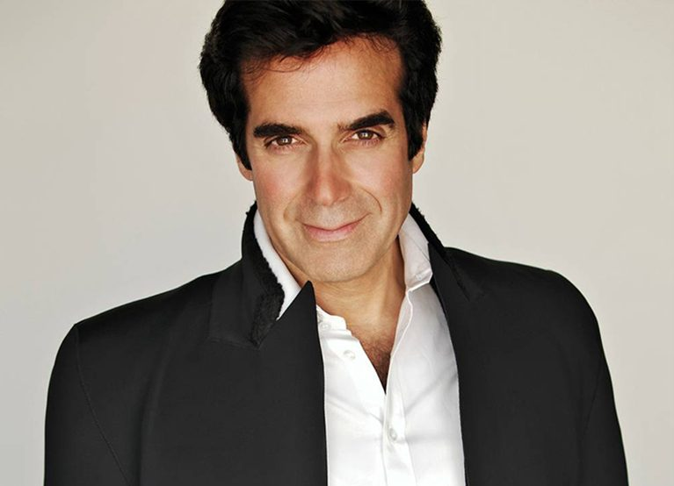
Magazines, Cards, Games

Slide 114
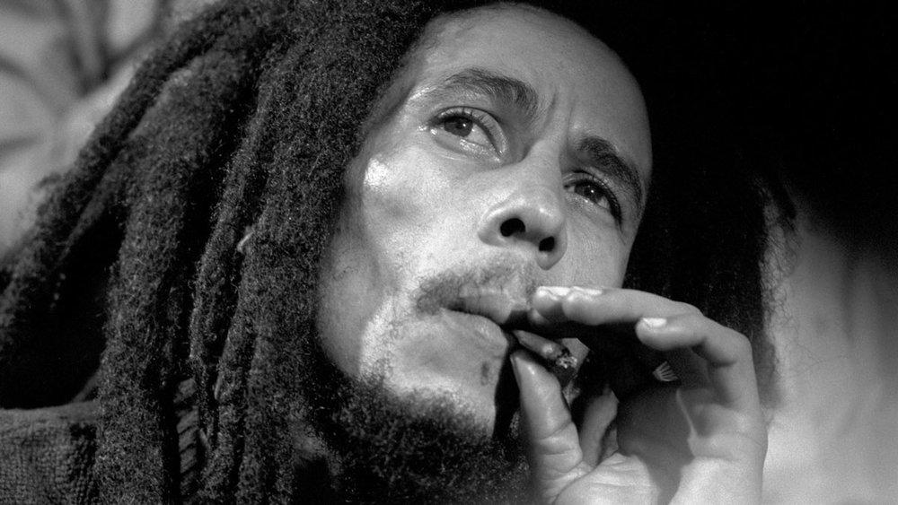
Music, Videos, Digital Media

Slide 115
Catholic Mysticism and Statues
No Christian believer needs any image, statue, candle, or object to have a personal relationship with the Lord Jesus Christ! The simple fact is this: Jesus is alive; these objects are dead and lifeless.

Slide 116
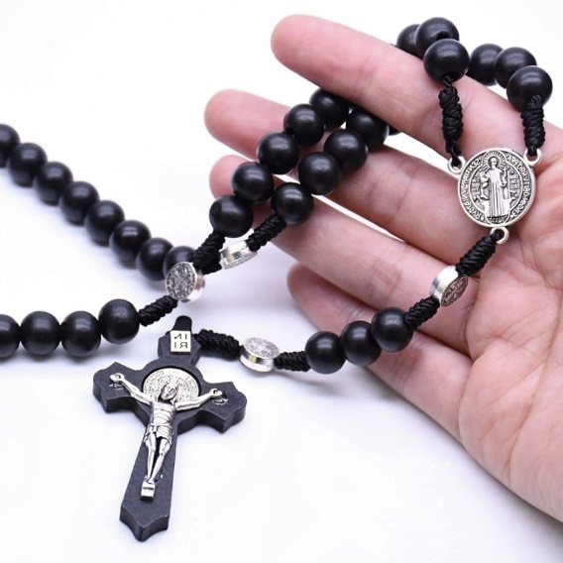
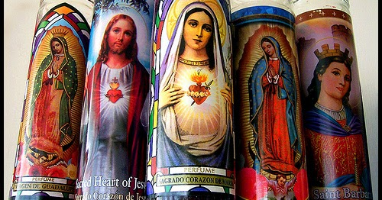
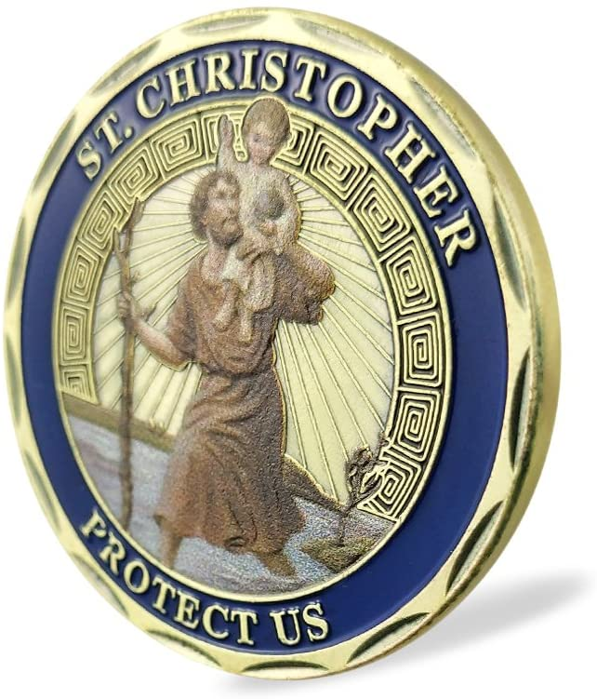
Catholic Mysticism and Statues

Slide 117
Sorcerers & Mediums

Slide 118
End of this Seminar
Softcover & Hardcover
Kindle
Audio
Videos
www.teacherofthebible.com

